Slide 1
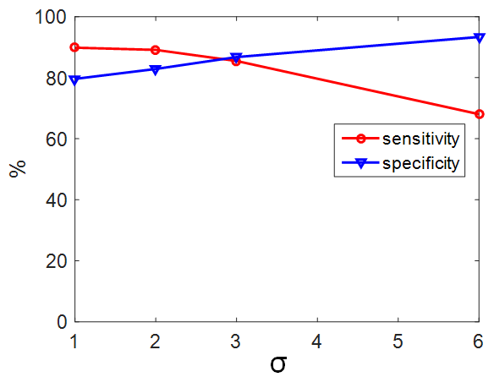
IEEE RCAR 2020 Digest Template
Performance Assessment of Artificial Intelligence Medical Device Software Using Synthetic Data
Hao Wang, Xiangfeng Meng, Chao Zhang, Jiage Li
Institute for Medical Device Control, National Institutes for Food and Drug Control， 31 Huatuo Rd, Daxing ,102629, Beijing, China
Fig. 7 Algorithm performance variation with focusing (red circle: sensitivity; blue triangle: specificity)

