Slide 1
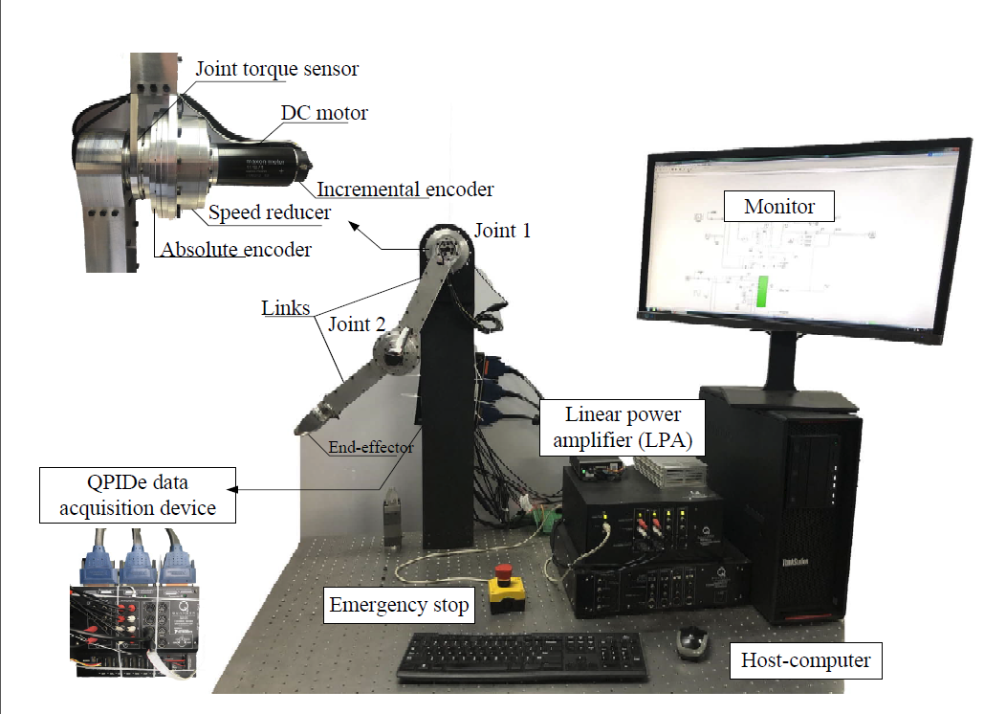
Joint Torque Feedback-based Decentralized
Neuro-optimal Control of Input-constrained Modular Robot Manipulator System
Bing Ma and Yuanchun Li
Control Science and Engineering, Changchun University of Technonlogy, China
A novel decentralized neuro-optimal control method of input-constrained MRM system is presented.
Adaptive dynamic programming
Joint torque feedback technique
Actuator saturation constraints
Experimental verification
2-DOF MRM experimental platform for verification of the developed method

