Slide 1
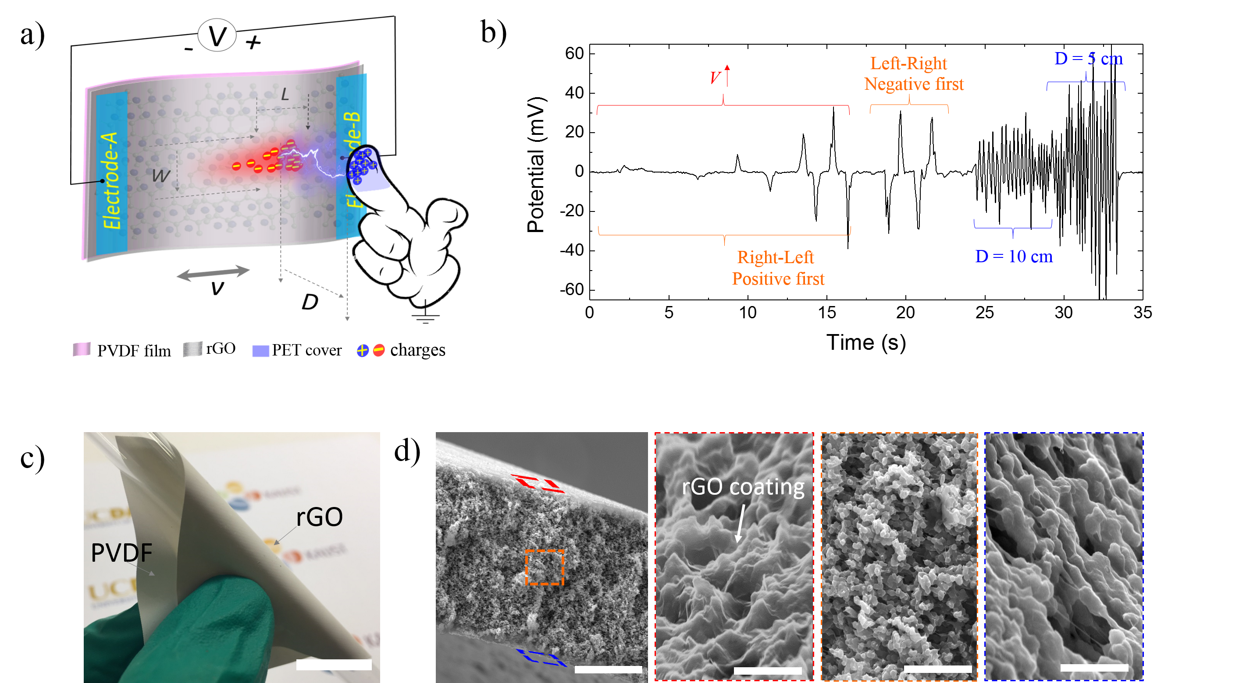
3-D Logic Motion Sensing of Polyvinylidene Fluoride based Flexible Interactive Electronics
Pengcheng Wu, Guanglin Li, and Yanlong Tai
Shenzhen Institutes of Advanced Technology, CAS, Shenzhen, 518055, China
Zhenguo Yang
Department of Materials Science, Fudan University, Shanghai 200433, China
Fabricate a new 3D tactile sensing technology based on rGOPF flexible film
Achieve a logic potential responds to various tactile motions accurately
Applications to human-machine interactions, human finger electronics
3-D Logic Motion Sensing

