Slide 1
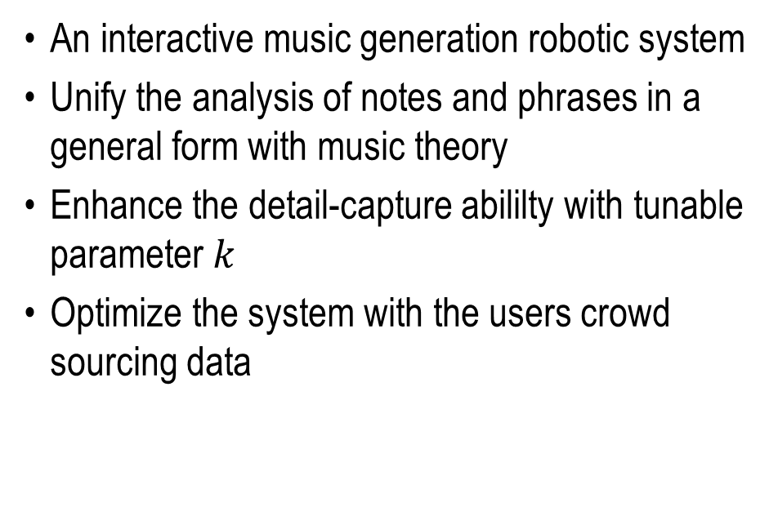
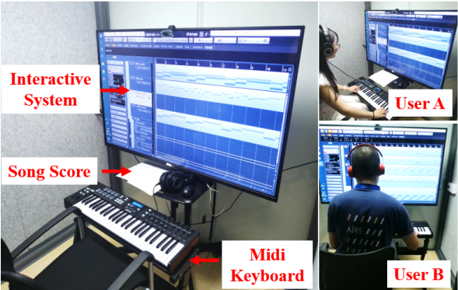
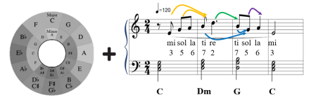
SongBot: An Interactive Music Generation Robotic System for Non-musicians Learning from A Song
Kaiwen Xue, Zhixuan Liu, Jiaying Li, Xiaoqiang Ji, Huihuan Qian
Shenzhen Institute of Artificial Intelligence and Robotics for Society (AIRS)
The Chinese University of Hong Kong, Shenzhen, China

