Slide 1
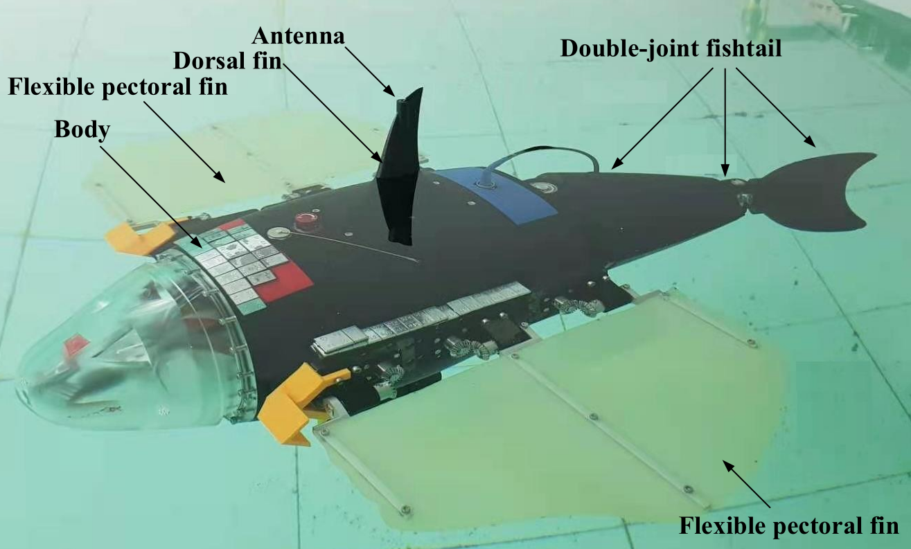
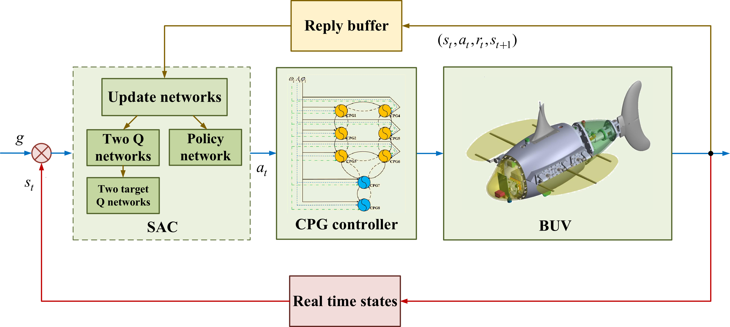
Locomotion Control of a Hybrid Propulsion Biomimetic Underwater Vehicle via Deep Reinforcement Learning
Tiandong Zhang, Rui Wang, Yu Wang, and Shuo Wang
Institute of Automation, Chinese Academy of Sciences, China
School of Artificial Intelligence, University of Chinese Academy of Sciences, China
A novel locomotion control method of biomimetic underwater vehicle (BUV) is proposed based on deep reinforcement learning.
A hybrid propulsion BUV named RoboDact is presented with two flexible long fins and a double-joint fishtail.
The feasibility and effectiveness of the proposed control method is demonstrated after extensive comparative simulations.
The RoboDact prototype and control architecture

