Slide 1
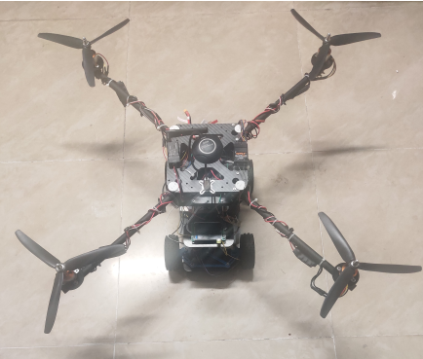
IEEE RCAR 2020 Digest
The Design of an Aerial/Ground Dual-modal Mobile Robot for Exploring Complex Environments
Daoxun Zhang, Ce Guo, Haoran Ren, Pengming Zhu, Ming Xu and Huimin Lu
Robotics Research Center, College of Intelligence Science and Technology, National University of Defense Technology, China
A novel design of a dual-modal mobile robot.
The robot possess aerial and ground movement capability.
The robot has high energy efficiency and rapid maneuverability.
The aerial/ground dual-modal mobile robot prototype

