Slide 1
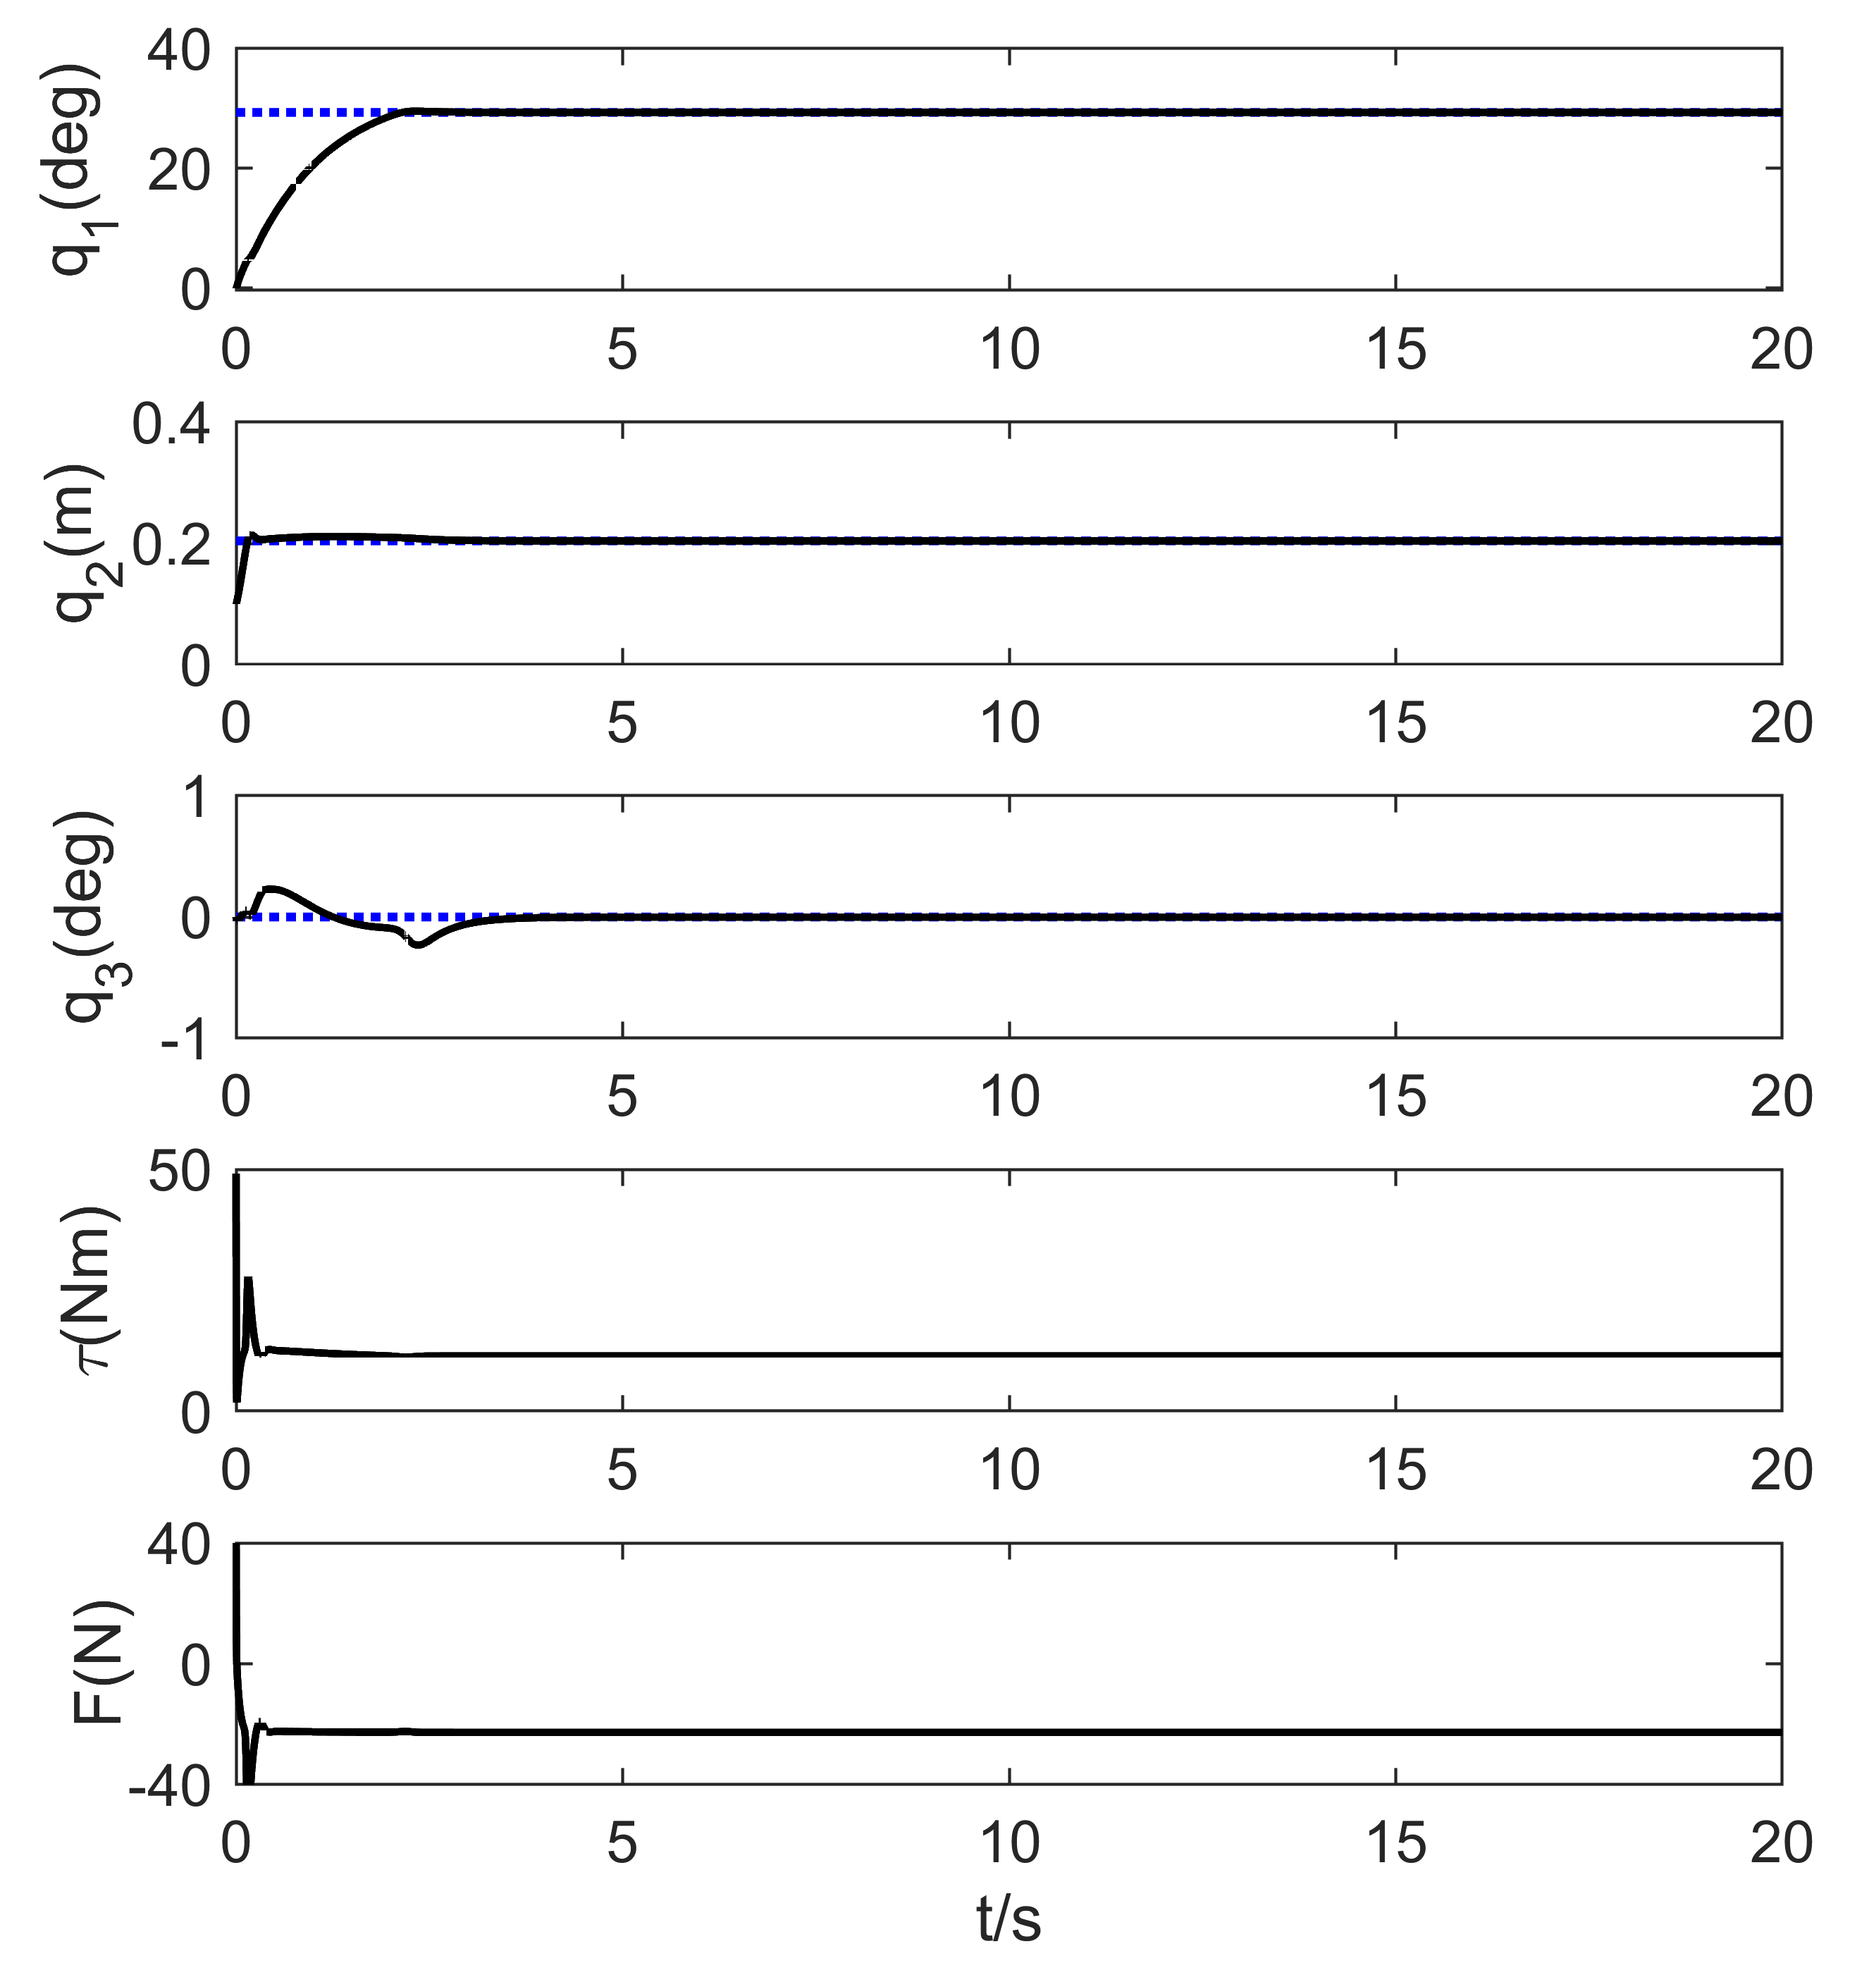
Stabilizing control for an offshore crane with unknown parameters
Zhi Li, Xin Ma and Yibin Li
School of control science and engineeringShandong University, China
The Dynamic model of an offshore boom crane is established in the presence of ship roll motion
A parameter independent coupling controller is proposed which combines the proportional derivative controller and the SMC, to regulate the cargo to desired positions.
The closed-loop stability is analyzed and the effectiveness is verified via simulation results
Simulation results under regular waves

