Slide 1
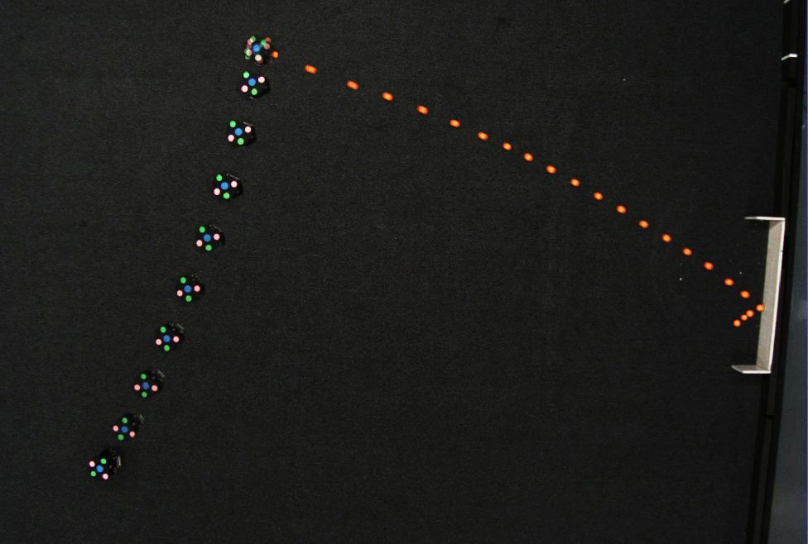
Multi-Stage Decision-Making Skill Learning for Soccer Robot
Zhike Chen, Zhiye He, Haozhe Du, Chenrui Han, Rong Xiong
College of Control Science and Engineering, Zhejiang University, Hangzhou, China.
Hierarchical Reinforcement Learning method is used to learn complex multi-stage decision-making skill
The method is validated by learning skill for robot on small size soccer robot platform
Our method has the advantage on higher success rate comparing with traditional methods.

