Slide 1
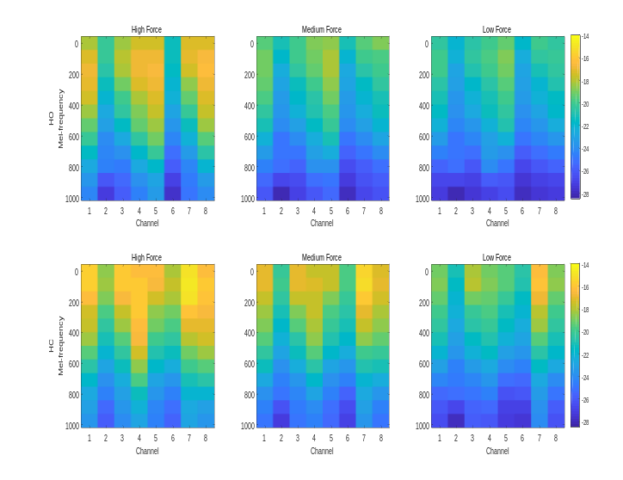
Toward reducing the effect of force variations on electromyography pattern recognition by Mel-frequency spectrum
Yan Liu, Lan Tian, Yue Zheng, Xiaomeng Zhou, Xiangxin Li*, and Guanglin Li
Shenzhen Institutes of Advanced Technology, Chinese Academy of Sciences，China
The energy distributions in frequency of different force levels were similar for the same motion class
A Mel filter bank is applied to the power spectrum to achieve the Mel-frequency spectrum (MFS)
For the un-trained high and low force levels, the accuracy increased by about 27% and 11% than TD feature set (MAV, WL, ZC,SSC)
log-MFS for HO and HC at different force levels.

