Slide 1
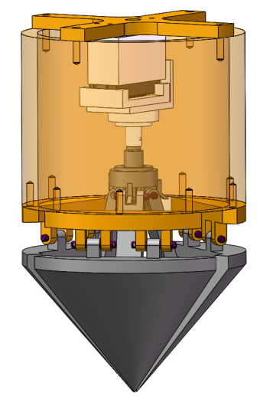
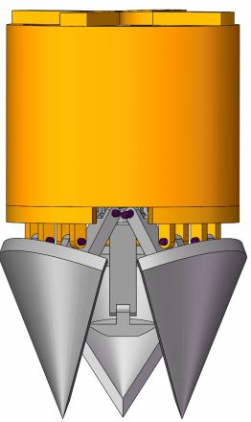
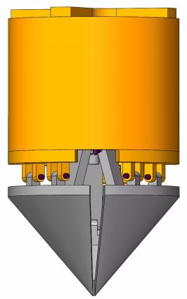
Design and Analysis of a Novel and High-efficiency Axe-foot Part for Razor Clam Inspired Anchoring Robot
Bingxin Zhao, Linsen Xu,
Hefei Institutes of Physical Science, Chinese Academy of Sciences, Hefei, China
Lei Liu
University of Science and Technology of China, Hefei, China
A novel and high-efficiency axe-foot part for razor clam inspired anchoring robot.
The axe foot of the robot plays an important role in the movements of the robot.
The rationality of the axe-foot part design is proved by mechanics analysis and dynamic analysis.
The actual burrowing ability and anchoring ability of the axe-foot part is verified by the results of these experiments.
(a) Opening
(b) Closing
The axe foot

