Slide 1
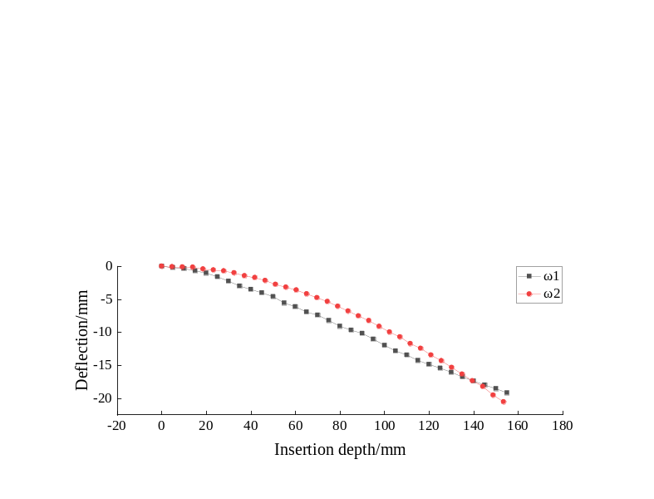
Research on Mechanical Properties of Bevel-Tip Needle Based on Image Guidance
Linze Wang , Dedong Gao* , Yan Zhao and Juntao Zhang
the School of Mechanical Engineering, Qinghai University, Xining
Jiali Cui
Department of Computer Technology and Application, Qinghai University, Xining
The flexible needle is a minimally invasive medical device mainly used for human biopsy.
the mechanical model between the needle holder and the force sensor is established.
A quasi-static cantilever beam model is established.
The results show that the cantilever beam model can predict the insertion trajectory.
Comparison of deflection ω1 and ω2

