Slide 1
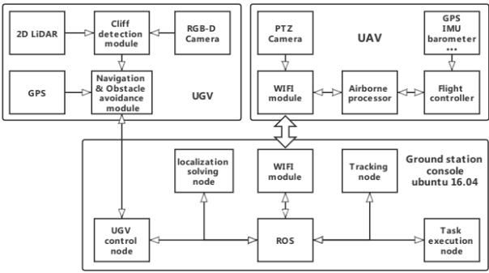
A Framework of Cooperative UAV-UGV System for Target Tracking
Zhilong Su, Can Wang, Xinyu Wu, Yao Dong, Jiangpeng Ni, Bailin He
Guangdong Provincial Key Lab of Robotics and Intelligent System, Shenzhen Institutes of Advanced Technology, Chinese Academy of Sciences, Shenzhen 518055, China
UAV is composed of an airborne processor, navigation module, perception module, and data transmission module.
The UGV is composed of a navigation module and a perception module.
The ground station control is installed on the UGV.
Framework of cooperative UAV-UGV system

