Slide 1
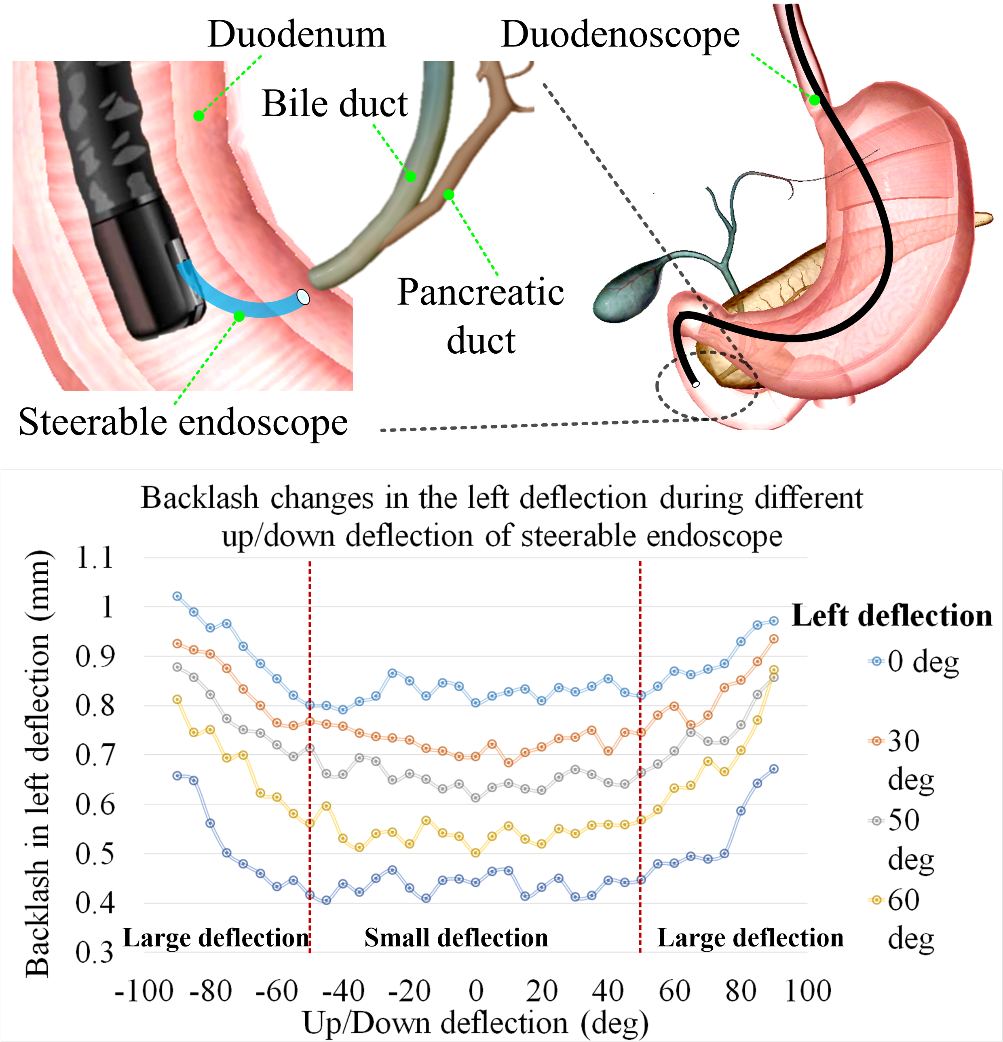
Data-Driven Modeling the Nonlinear Backlash of Steerable Endoscope Under a Large Deflection Cannulation in ERCP Surgery
Wei Jiang, Tao Yu, Xiao He, Yongming Yang, Hao Liu
Shenyang Institute of Automation, Chinese Academy of Sciences, China
Zhidong Wang
Department of Advanced Robotics, Chiba Institute of Technology, Japan
The backlash limits the positioning and orientation accuracy of the tendon-sheath-driven endoscope under large deflection.
We proposed to model the backlash of two DoFs endoscope by using a data-driven method.
Trajectory following and orientation results show that the model can accurately describe the nonlinear backlash.
The Nonlinear backlash of steerable endoscope in ERCP surgery

