Slide 1
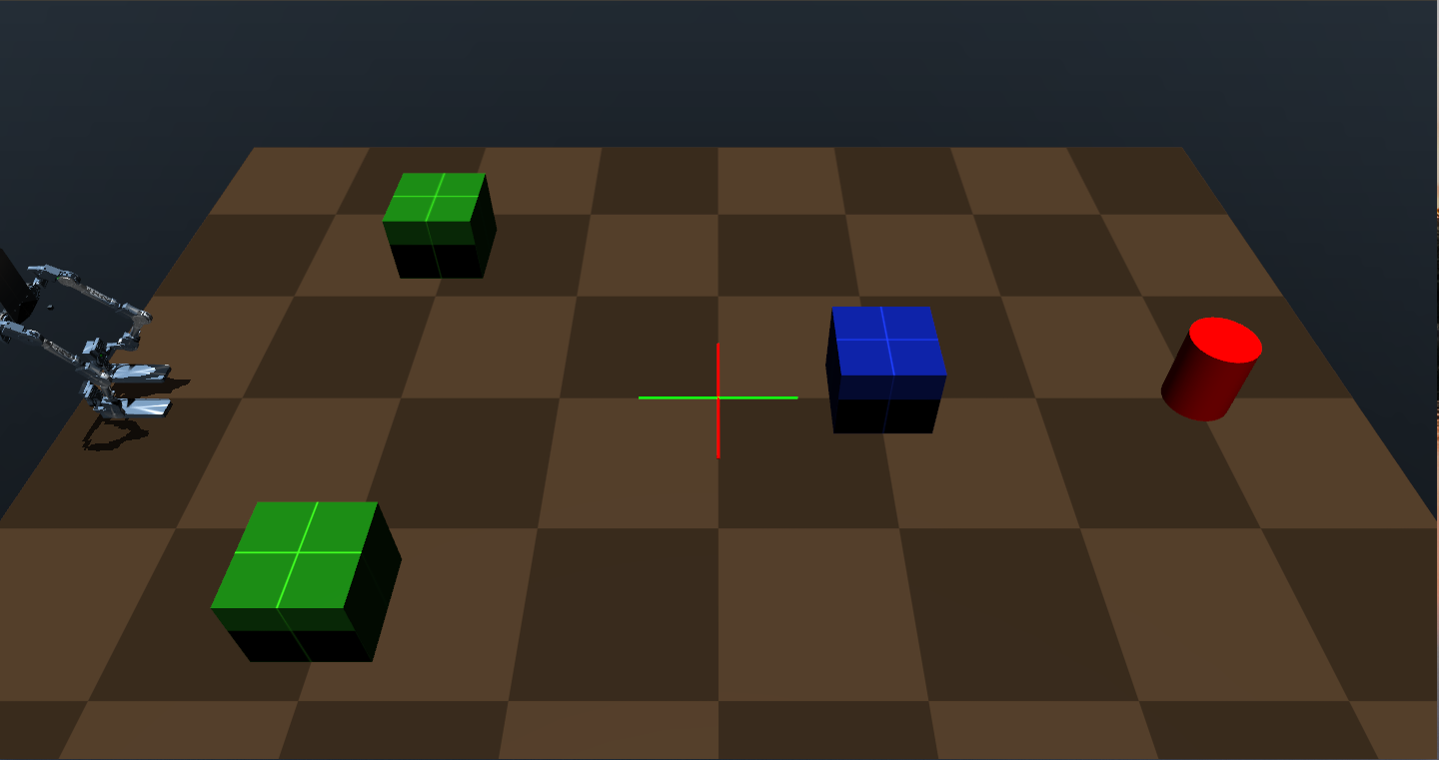
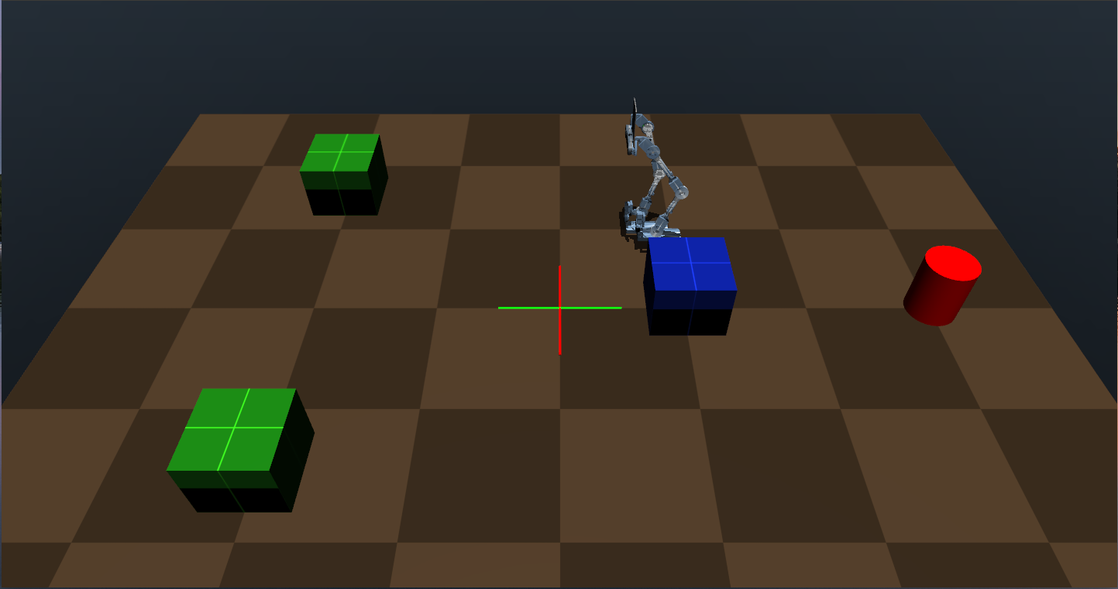
A Motion Planning Method Based on HRL for Autonomous Exoskeleton
Yao Dong, Yong He, Zhilong Su, JiangPeng Ni,
Wei Feng, Xinyu Wu
Guangdong Provincial Key Laboratory of Robotics and
Intelligent System, Shenzhen Institutes of Advanced Technology,
Chinese Academy of Sciences, Shenzhen 518055, China
Propose a Motion Planning algorithm(HPPO) to solve the path planning and gait policies of autonomous exoskeleton(Auto-LEE) .
HPPO contains two levels: High-level path planning controller (HL); Low-level gait generation controller(LL).
HL is responsible for planning a reasonable path in various complex terrains; LL generates a movement gait and executes actions to complete the interaction with the environment

