Slide 1
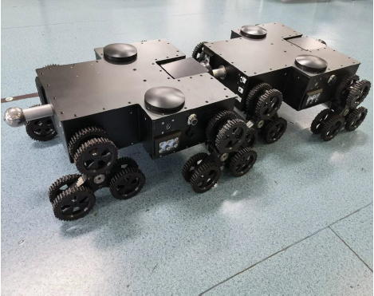
Bionic Design of a Self-Reconfigurable Modular Robot for Search and Rescue
Guangju Gao, Jingshuai Liu, Yong He,
Jianquan Sun and Xin yu Wu
Shenzhen College of Advanced Technology, Chinese Academy of Sciences,China
A novel self-reconfigurable modular robot for search and rescue.
The modular robot can be connected or disconnected according to the actual task requirements
The robot has a strong flexibility to cross obstacles in a disaster environment.

