Slide 1
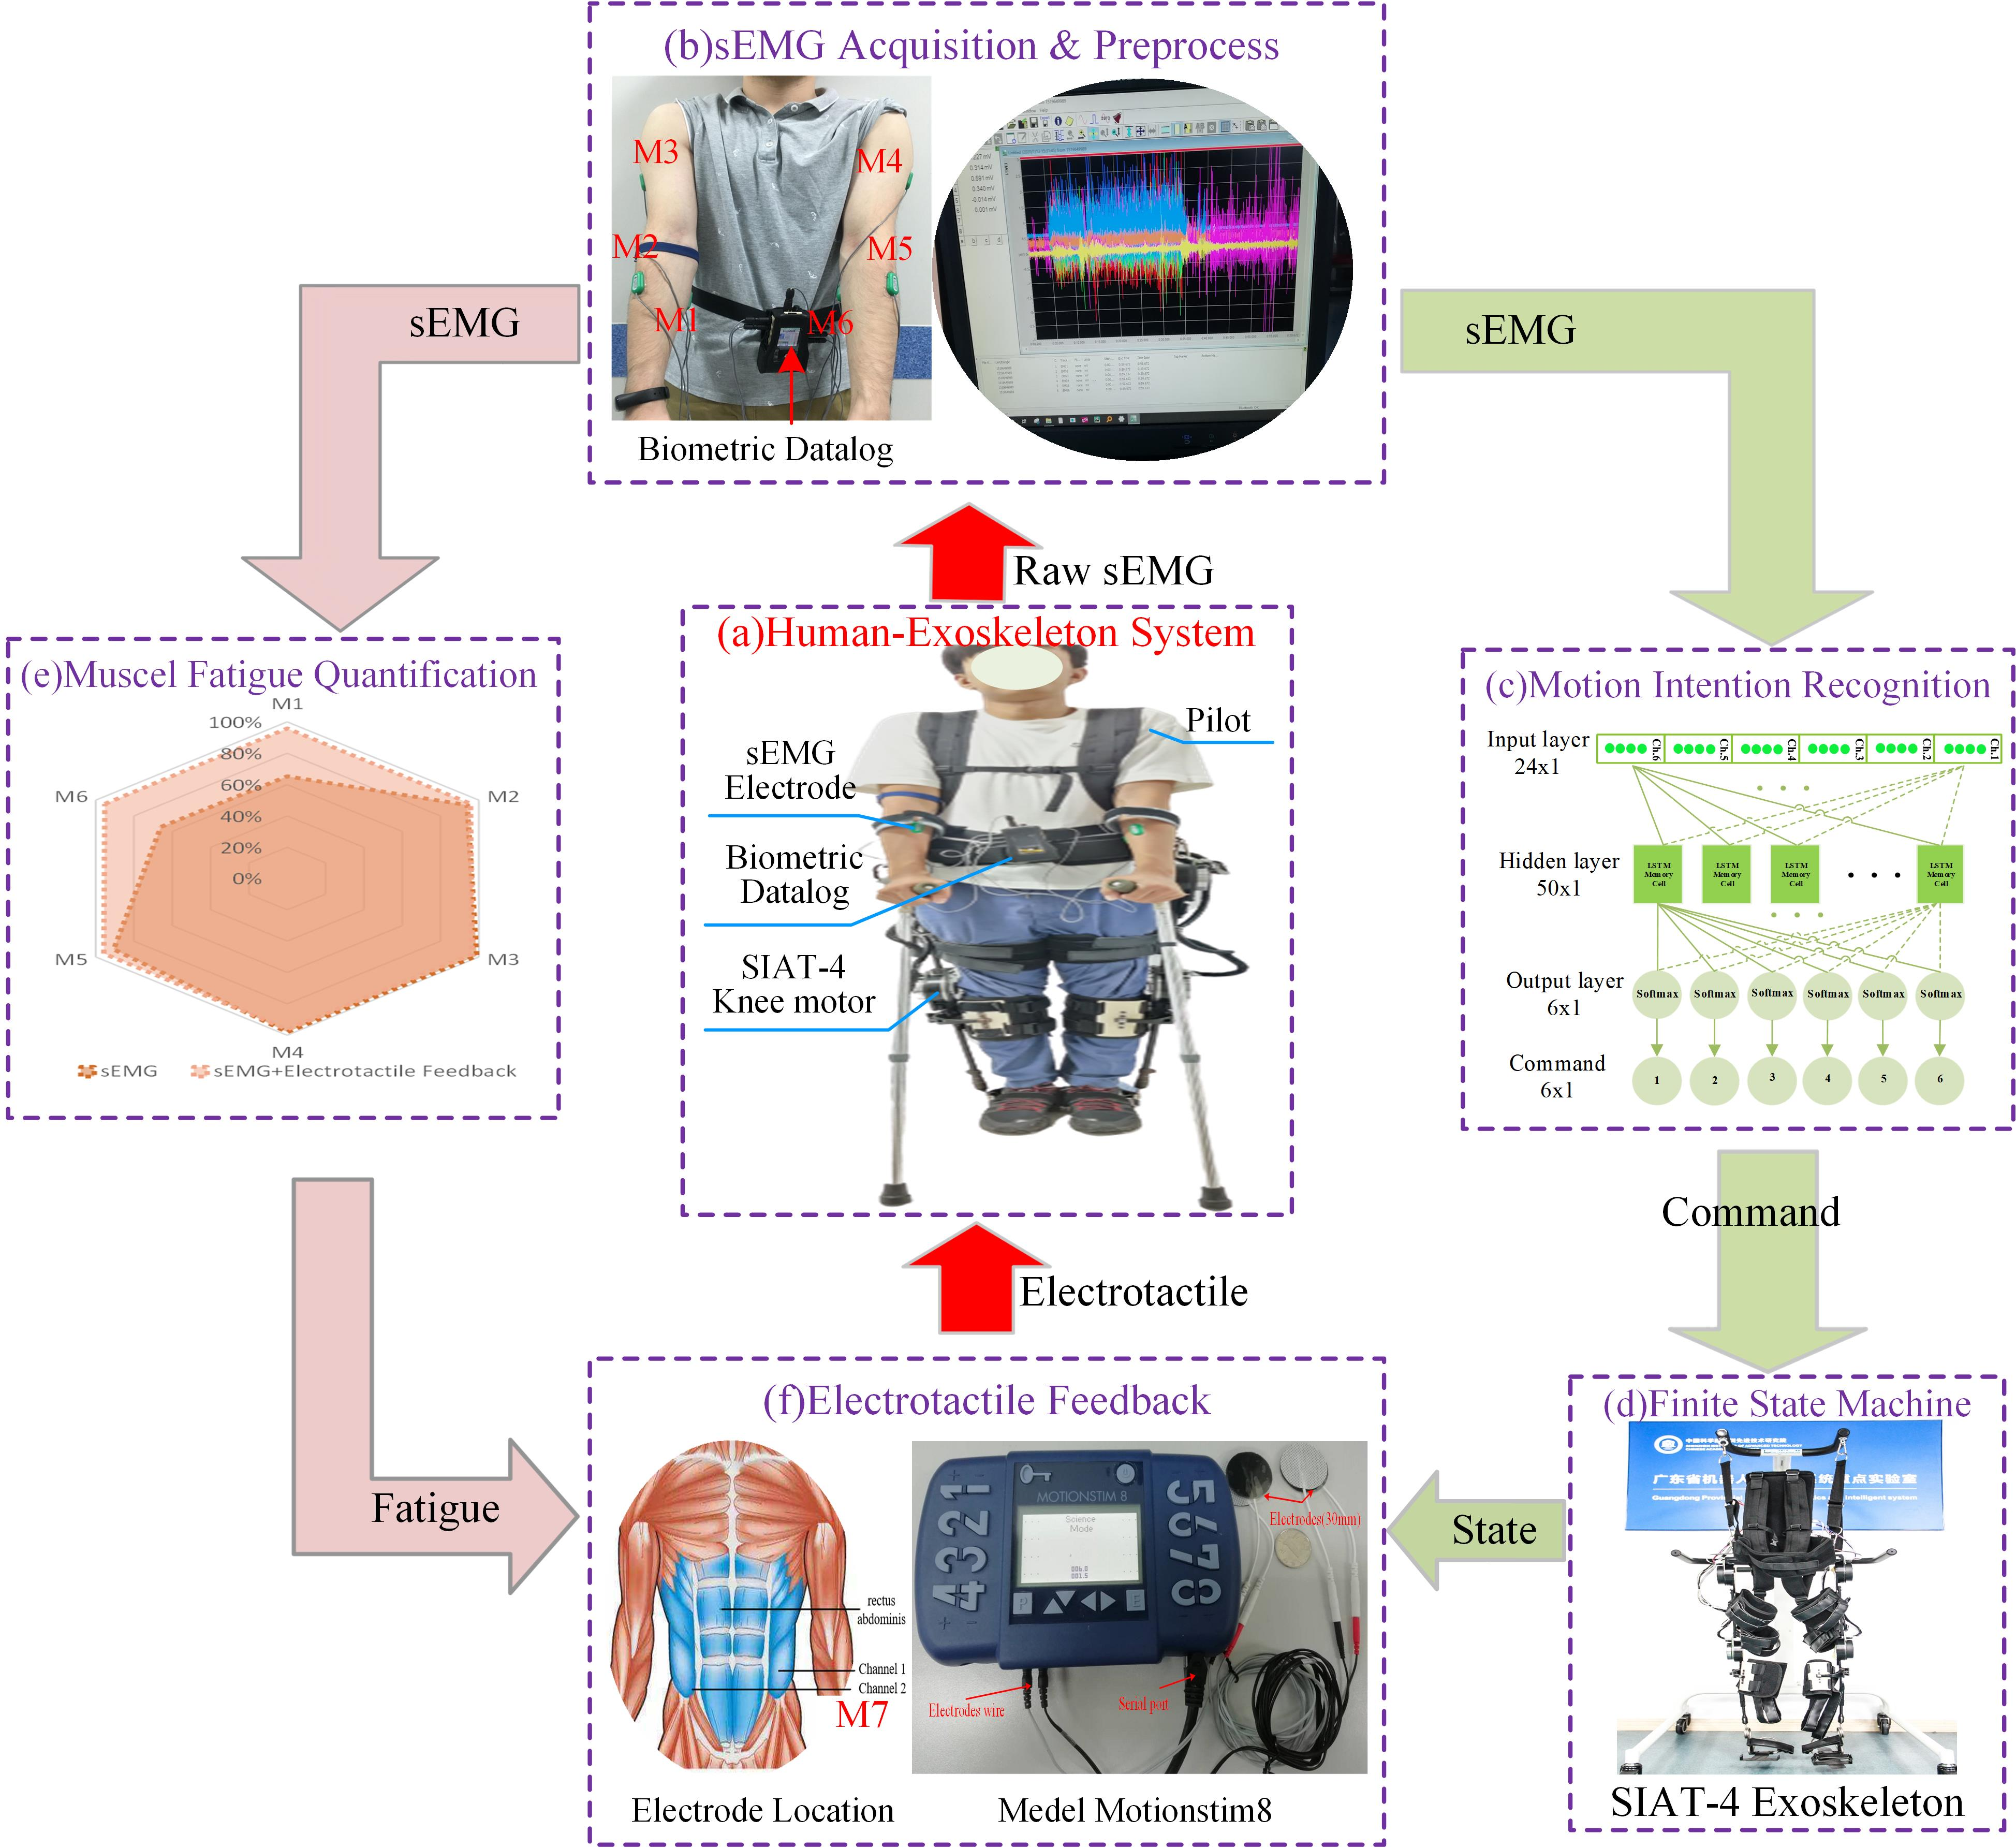
A Framework for Human-Exoskeleton Interaction Based on sEMG Interface and Electrotactile Feedback
Shengcai Duan, Can Wang, Mengyao Li, Zhilong Su,
Jiaqing Liu and Xinyu Wu
Shenzhen Institute of Advanced Technology
University of Chinese Academy of Sciences, China
Six-types motion intention is recognised by LSTM neural network based on sEMG of arms.
The electrotactile is applied to feedback of five kinds states of exoskeleton and making up for the losing proprioception.
Muscle fatigue of arms during use of exoskeleton is monitored and quantified with sEMG.

