Slide 1
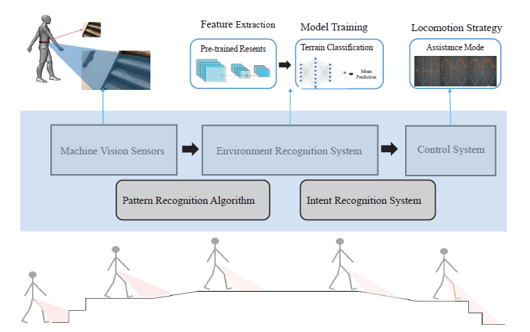
environment classification and recognition for soft lower-limb exosuit
Ni Jiangpeng and Wang Zhuo
Shenzhen Institute of Advanced Technology, Chinese Academy of Sciences
Reliable environmental context prediction is critical for wearable robots to assist terrain-adaptive locomotion.
terrain classification and recognition system (TCRS) is designed for lower-limb soft exosuit robots.
The results in this study may lead to novel context recognition strategies in reliable decision-making, improved intelligent system design in various applications.
A figure here
Automatic motion pattern adaptation of soft lower-limb exosuit based on terrain recognition.

