Slide 1
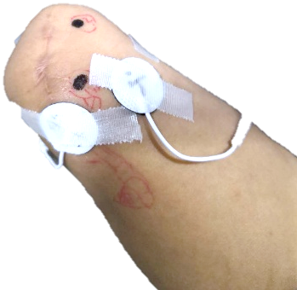
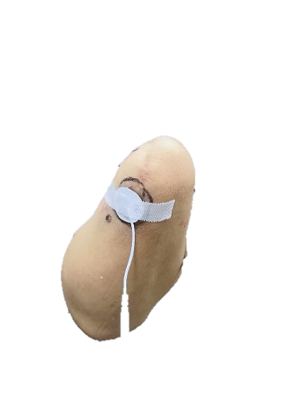
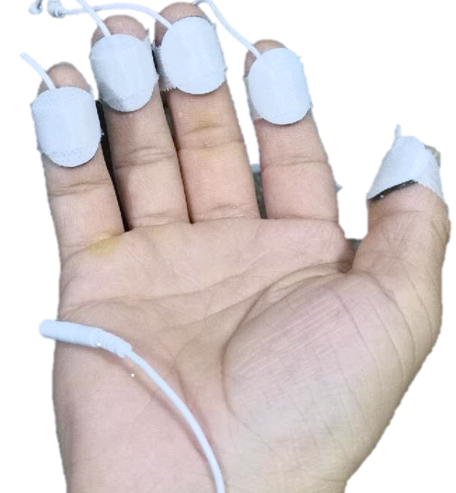
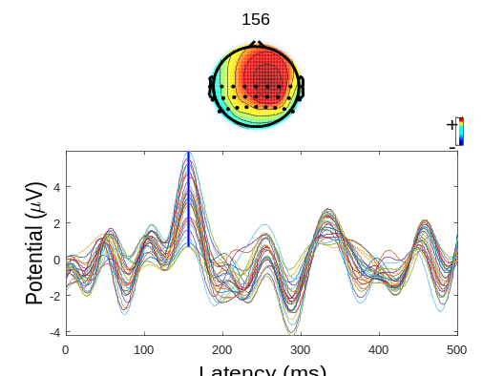
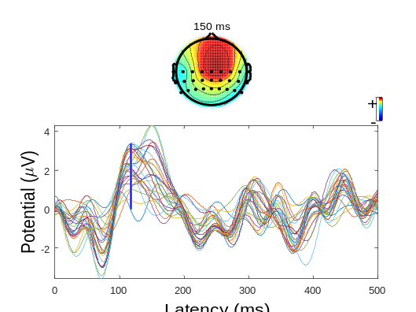
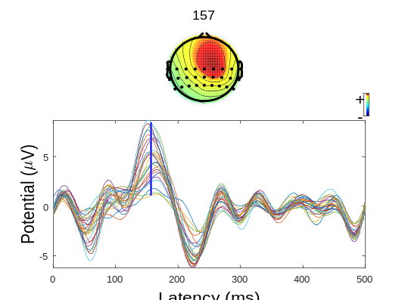
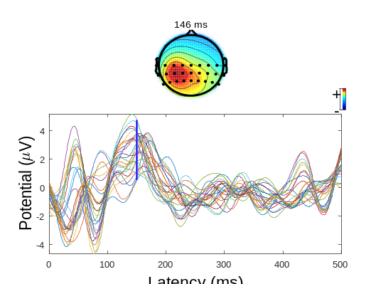
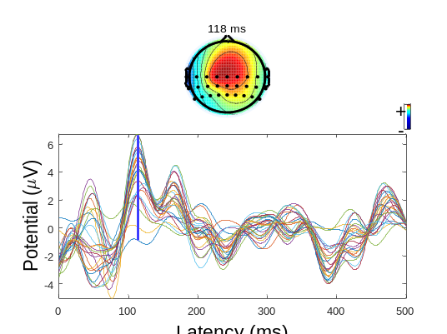
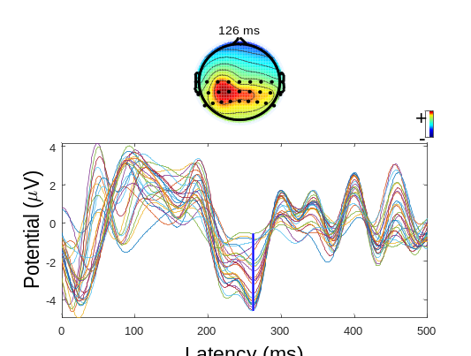
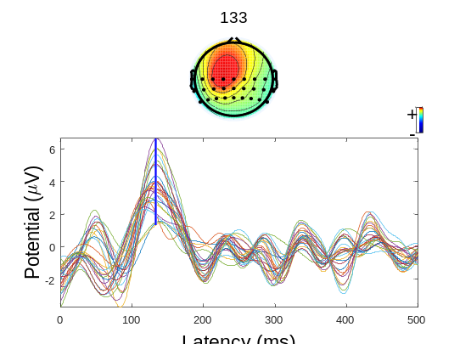
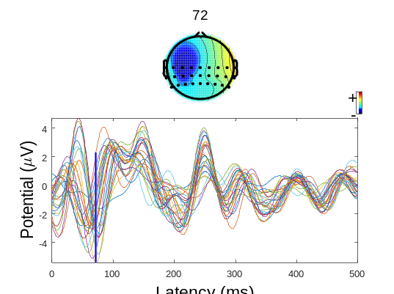
Evaluation of Phantom Finger Sensation Evoked by Electrical Stimulation for Transradial Amputee: A Case Study
Yingying Wang, Xi Tang, Naifu Jiang, Lan Tian, Yue Zheng, Xiangxin Li, Guanglin Li*, and Peng Fang*
The CAS Key Laboratory of Human-Machine Intelligence-Synergy Systems, Shenzhen Institutes of Advanced Technology, China
Jun Xie
The School of Mechanical Engineering, Xi’an Jiaotong University, China
The non-invasive Electrical Nerve Stimulation (TENS) is used to reestablish the sensory function for a limb amputee
An approach based on electroencephalogram (EEG) is proposed to evaluate the evoked somatosensory information
Somatosensory information evoked at different positions of the stump could be distinguished by characteristics of Event-Related Potential (ERP)
PFPEA on the residual limb of amputee
Contralateral finger pulps
Cathode electrodes
R3
R4
R2
L2
L1
R5
R1
L3
(a)
(b)
L1
L2
L3
R1
R2
R3
R4
R5
(c)

