Slide 1
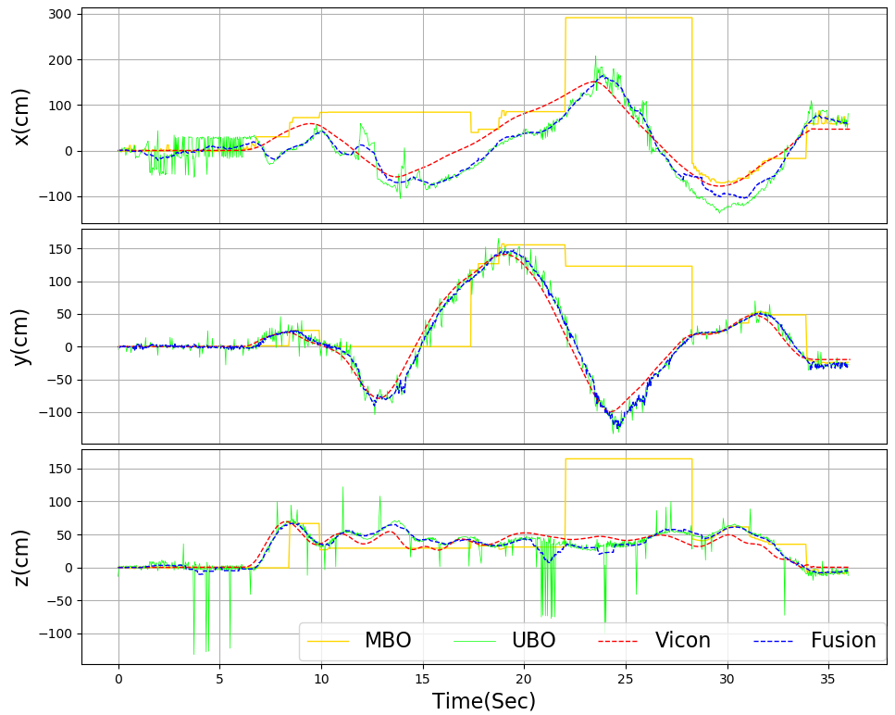
A cooperative positioning approach of Unmanned Aerial Vehicles with Accuracy and Robustness
Ziwei Zhou, Ziying Lin, Wei Dong and Xiangyang Zhu
School of Mechanical Engineering, Shanghai Jiao Tong University, China
Yi Ni
Shanghai Electro-Mechanical Engineering Institute, China
A novel cooperative positioning approach named is proposed, which is comprised of a marker-based position estimation and an end-to-end UAV detection.
A data fusion algorithm is applied to ensure the accuracy and robustness of the localization.
Extensive experiments under different environments are carried out to verify the effectiveness of the proposed method.
Estimation Result of proposed method in dark environment

