Slide 1
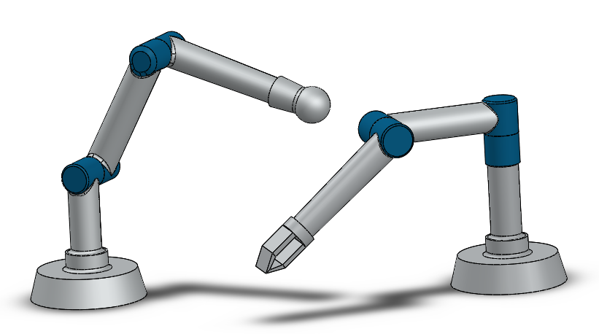
A Non-zero-sum-based Neural-optimal control method for Modular and Reconfigurable Robot Systems
Tianjiao An, Xinye Zhu, Yuanchun Li and Bo Dong
Department of Control Science and Engineering,
Changchun University of Technology, Changchun, China
Using non-zero-sum neural-optimal control on modular and reconfigurable robot.
Extending ADP to non-zero-sum algorithm complete trajectory tracking task.
Each module is regarded as one player in the game theory.
A figure here

