Slide 1
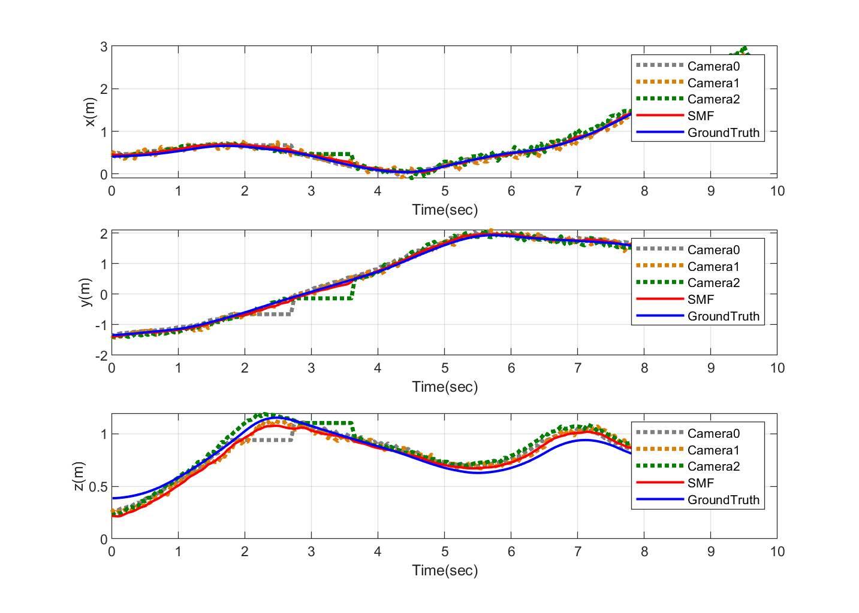
Unmanned Aerial Vehicle’s State Estimation with Multiple Unmanned Ground Vehicles Cooperative Observation Based on Set-Membership Filter
Jikang Hou, Jiayi Li and Wei Dong
School of Mechanical Engineering, Shanghai Jiao Tong University, China
Yi Ni
Shanghai Electro-Mechanical Engineering Institute, China
There are usually problems with low observation accuracy or robustness and prior assumptions about noises.
Set-Membership Filter (SMF) method is applied to the cooperative observation system.
The application of SMF algorithm in single and multiple UGVs cooperative observation system with obstacles are researched respectively.
Experiments are conducted to verify accuracy and effectiveness of SMF method.
A figure here
Estimation Results of Multiple UGV Cooperative Observation

