Slide 1
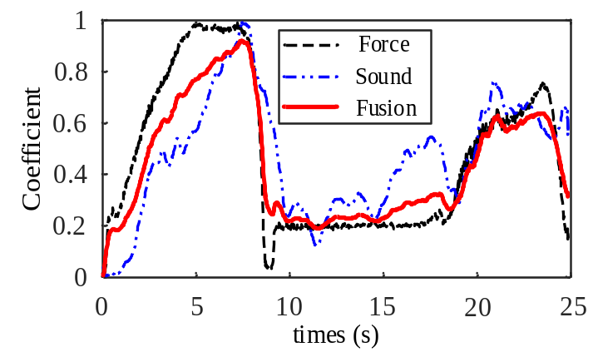
State Sensing of Spinal Surgical Robot Based on Fusion of Sound and Force Signals
Meng Li^{1,2}, Xiaozhi Qi², Fengqing Guan², Haiyang Jin³, Ying Hu², Wei Tian⁴
¹Harbin Institute of Technology(Shenzhen), China
²Shenzhen Institute of Advanced Technology, CAS, China
³Shenzhen Broadcare medical robotics co. Ltd., China
⁴Shenzhen Beijing Jishuitan Hospital, China
This paper proposes a state sensing method of spinal surgical robot based on multi-source information.
The IMM and SVM is performed to train and identify the feature quantities of the sound and force signals.
The effectiveness of the proposed identification method is verified and compared by using multi-parameter experiments.
Fusion result of sound and force signals by IMM fusion method

