Slide 1
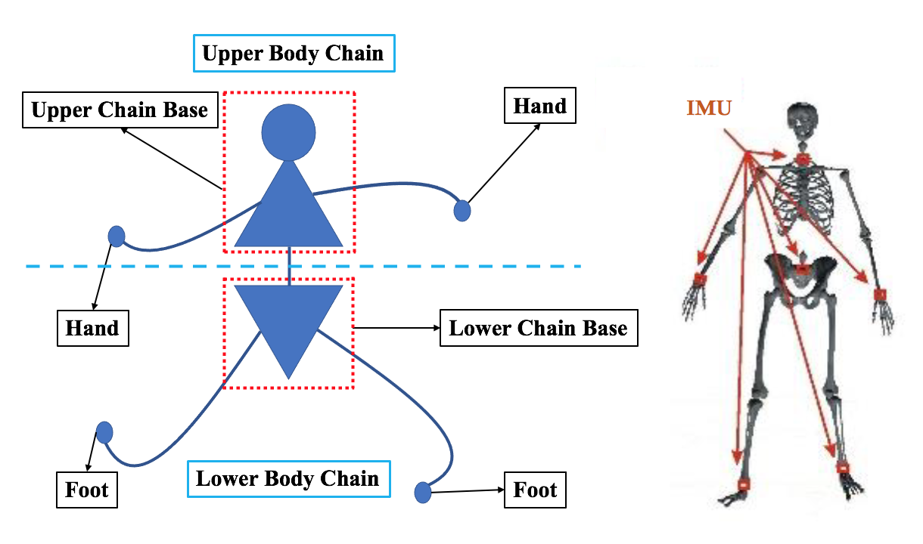
A Pilot Study on a Multimodal Wearable System by Applying a Two-Chain Biomechanical Model in the Alpine Ski Slalom
Ye Wang, Tianqi Shao, Peng Jiang, Lin Wang and Guanglin Li
SIAT, Chinese Academy of Sciences, China
Gongbing Shan
Kinesiology & Physical Education, University of Lethbridge, Canada
Proposing a wearable system to monitor, acquire and fuse multi-source signals in real-time for skiers
Adopting the two-chain biomechanical model as a basis
Demonstrating multiple IMUs can work simultaneously in the same coordinate system with high consistency
The two-chain biomechanical model

