Slide 1
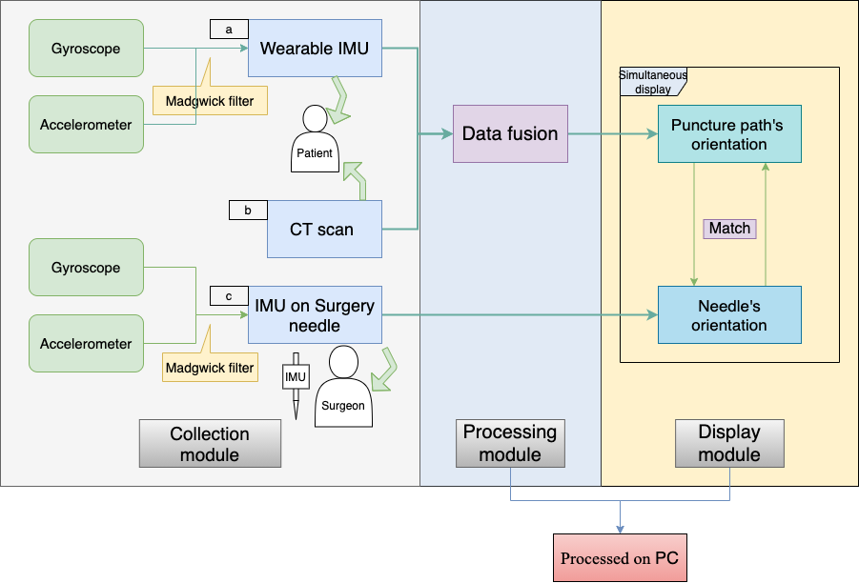
A Preliminary Study on an IMU-Based Surgery Assisting Method for Minimally Invasive Puncture of Intracranial Hematoma
Tianqi Shao¹, Ye Wang¹, Peng Jiang¹, Chong Wu², Guanglin Li¹, Lin Wang¹, and Shiwei Du²
¹Shenzhen Institutes of Advanced Technology, Chinese Academy of Sciences
²Department of Neurosurgery, Shenzhen University General Hospital
A real-time processing navigation system for assisting minimally invasive puncture and drainage (MIPD) of intracranial hematoma (ICH).
Initial Measurement Units(IMU)-based method for tracking puncture path and surgery needle.
A data fusion method fusing IMUs and CT data.

