Slide 1
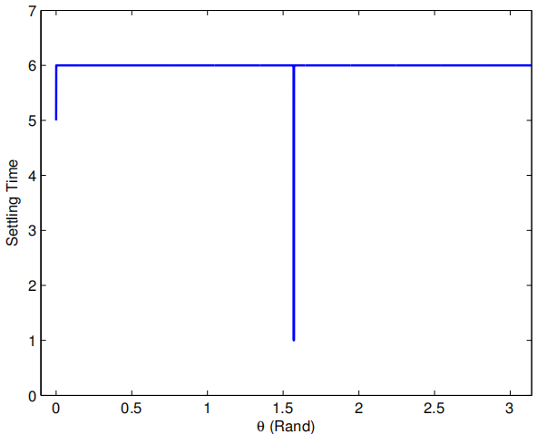
Optimized Design of Settling Time for Multi-model Systems
Miaomiao Wang¹ Zhendong Sun²
Academy of Math. & System Science, Chinese Academy of Sciences
College of Automation, Shandong University of Science & Technology
The problem of settling time optimization for a class of multi-model systems is addressed.
An upper bound estimate is obtained based on the path-wise contraction of stabilizability
The proposed design procedure is an algorithm that terminates in a finite number of steps.
A numerical example is presented to validate the proposed scheme.
State settling time

