Slide 1
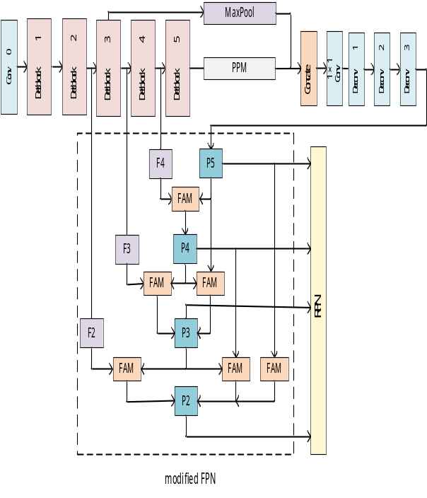
Algorithm for the Detection of Thin Strip Shaped Structural Small Diseases on Airport Pavement based on improved pyramid and feature fusion
Haifeng Li, Hongyang Han, Jianping Zong, and Jilin Li
College of Computer Science and Technology, Civil Aviation
University of China, China
Zhongcheng Gui
Shanghai Guimu Co. Ltd, China
This paper proposes a deep Neural Network algorithm, named as DFAMNet, based on improved pyramid and feature fusion.
The method improves the detection accuracy of small target diseases in the thin strip shape on the airport pavement.
Experimental results have verified the efficacy of the proposed method.

