Slide 1
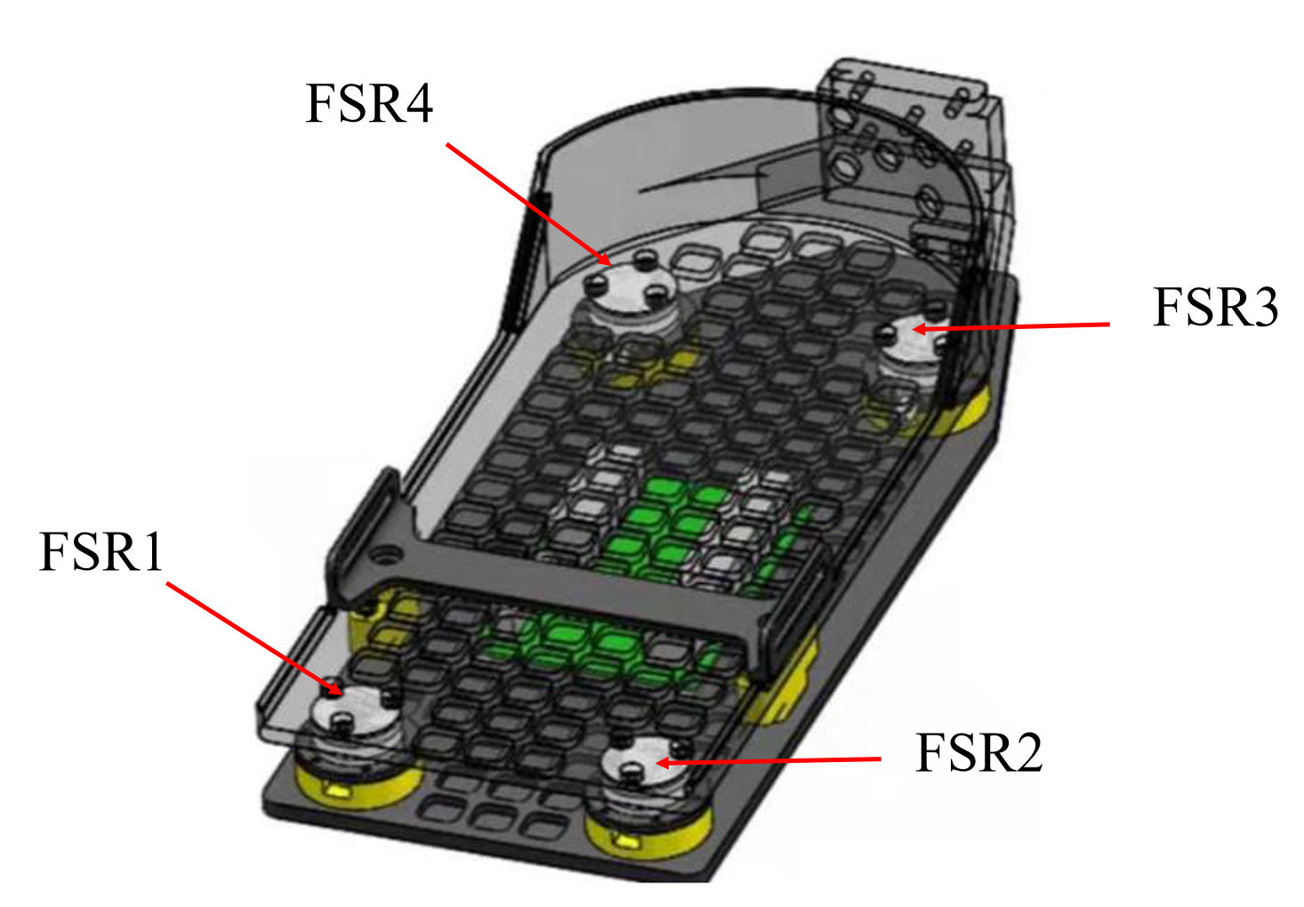
The Measuring ZMP of Self-balancing Exoskeleton Robot is Calibrated by Using The Neural Network
Yang Xu and Yang Xiao
School of Automation, Chongqing University of Posts and Telecommunications, Chongqing
Yue Ma, Liangsheng Zheng and Yong He
Shenzhen Institute of Advanced Technology, Chinese Academy of Sciences, Shenzhen
The footplate is used with the double-deck structure in this experiment.
The footplate makes the ZMP have a large measurement error.
Four kinds of neural networks are used to calibrate measured position of ZMP.
get the position of the ZMP by measuring the pressure of the footplate.

