Slide 1
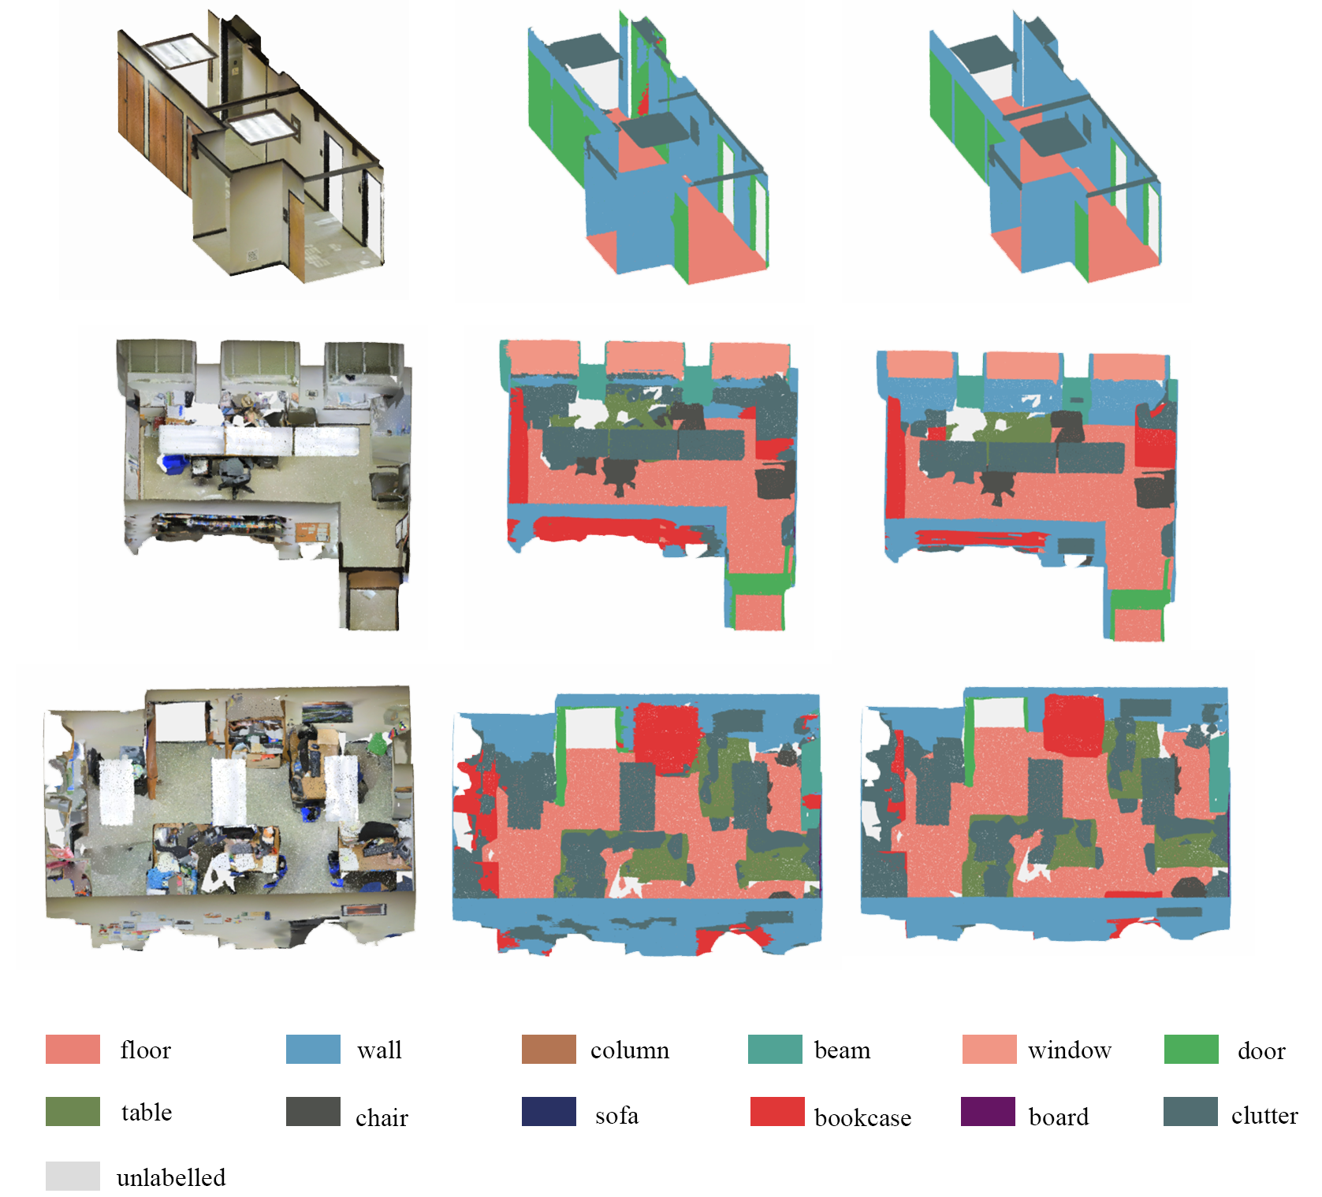
Dilated Nearest-Neighbor Encoding for 3D Semantic Segmentation of Point Clouds
Xiaoyuan Fan, Lei Wang and Jun Cheng
Shenzhen Institute of Advanced Technology， (CAS), China
Shan Jiang and Senwei Ma
University of Michigan, United States
A dilated nearest-neighbor encoding is introduced to the point cloud sampling network.
One end-to-end point cloud semantic segmentation framework has been presented.
We have achieved better performance than state-of-the-art methods on the large-scale benchmark --- S3DIS dataset.
Visualization of semantic segmentation on S3DIS

