Slide 1
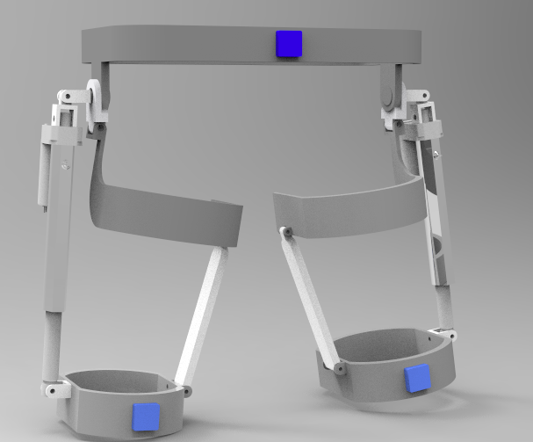
Design and Simulation of a Hip Exoskeleton for Lateral Walking
Zhang Zhewen and Cao Wujing
Shenzhen Institute of Advanced Technology, Chinese Academy of Sciences
The effect of lateral walking training on human rehabilitation is analyzed and discussed.
Analysis of transverse walking gait law.
Structural design of lateral walking assist exoskeleton.
The mathematical modeling and simulation are carried out for the mechanism design..
A figure here
Virtual prototype of transverse exoskeleton

