Slide 1
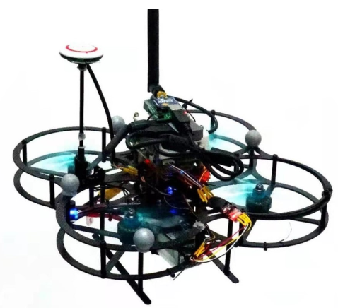
Efficient Learning-based Trajectory Tacker for Quadrotor at High-speed Flight
Peng Peng, Gang Chen and Wei Dong
School of Mechanical Engineering,Shanghai Jiaotong University, China
Yi Ni
Shanghai Electro-Mechanical Engineering Institute, China
This paper aims to improve the accuracy of the
trajectory tracking of the quadrotor
Combining traditional PID controller with the idea of neural network modeling based MPC.
The tracking performance is obviously improved both in simulation and experiment.
Home-made quadrotor for tracking experiment

