Slide 1
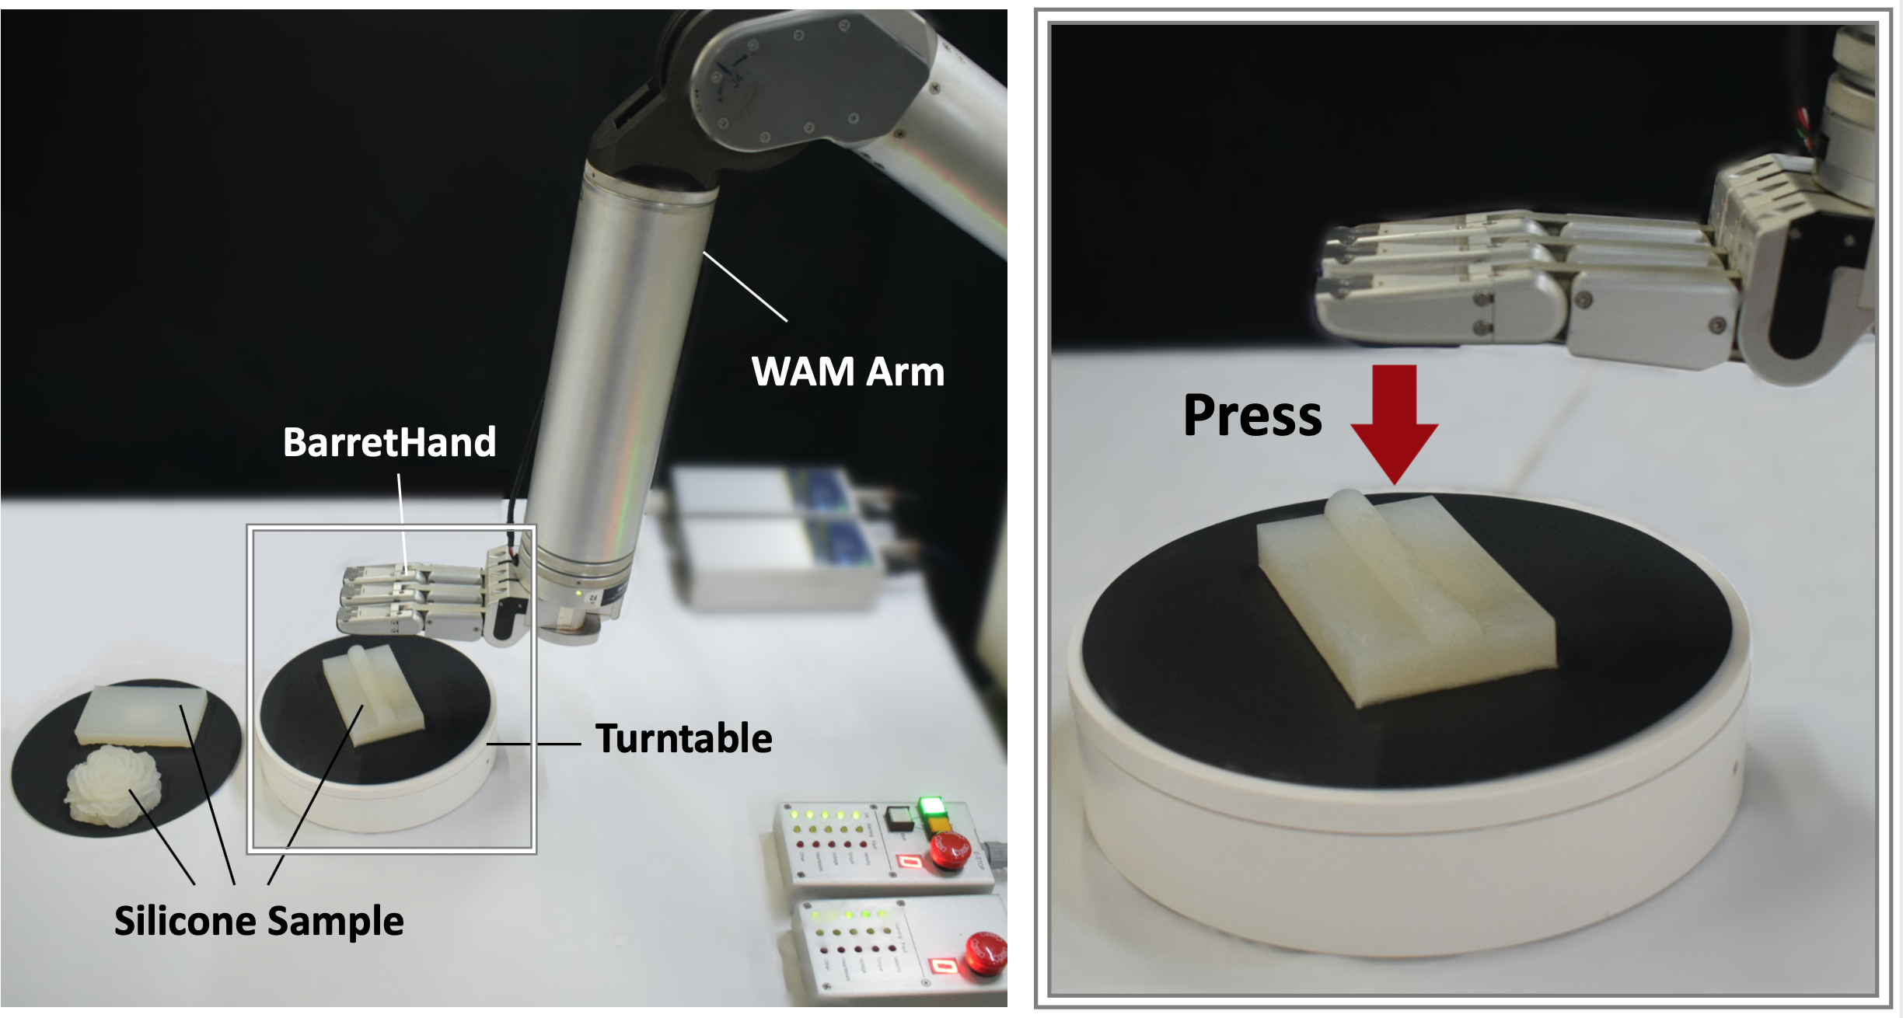
TactCapsNet: Tactile Capsule Network for
Object Hardness Recognition
Senlin Fang¹, Tingting Mi¹, Zhenning Zhou¹, Chaoxiang Ye¹,
Chengliang Liu¹, Hancheng Wu¹, Zhengkun Yi^{1, 3} and Xinyu Wu^{2,4}
¹Shenzhen Institutes of Advanced Technology
²Guangdong Provincial Key Lab of Robotics and Intelligent System
³Shenzhen Key Laboratory of Smart Sensing and Intelligent Systems
⁴SIAT Branch, Shenzhen Institute of Artificial Intelligence
and Robotics for Society
Develop a method of constructing the tatile image which could make full use of the spatio-temporal information.
Introduce a TactCapsNet for object hardness recognition.
Collect the tactile hardness dataset by using the Barrett Hand to press three shapes of silicone samples with 13 hardness levels.

