Slide 1
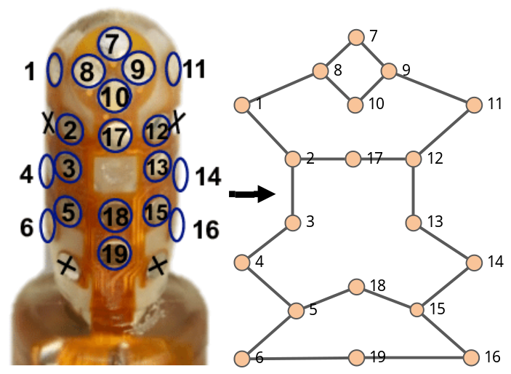
Tactile Grasp Stability Classification Based on Graph Convolutional Networks
Tingting Mi^{1,2}, Dashun Que¹, Senlin Fang², Zhenning Zhou²,
Chaoxiang Ye², Chengliang Liu², Zhengkun Yi² and Xinyu Wu^{2,3}
¹Wuhan University of Technology
²Shenzhen Institutes of Advanced Technology
³SIAT Branch, Shenzhen Institute of Artificial Intelligence
and Robotics for Society
Transform the electrode values of the BioTac sensor into a graph structure
Complete the convolution operation on the tactile graph
Present two fusion strategies to integrate the features of multiple sensors

