Slide 1
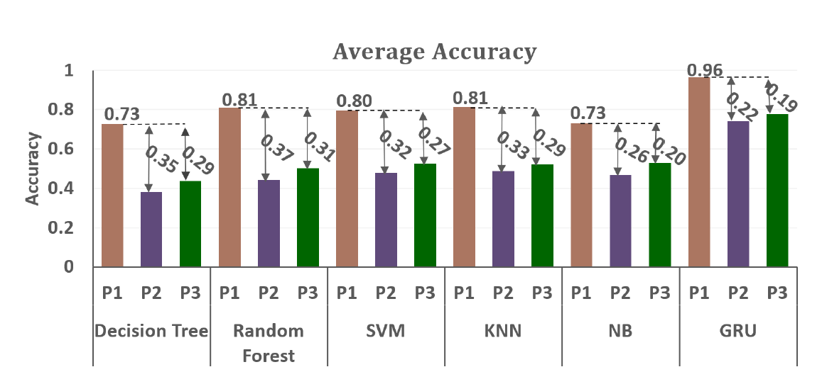
sEMG-Based Gesture Recognition Using GRU With Strong Robustness Against Forearm Posture
Rui Chen^{1;2}, YuanZhi Chen¹, Weiyu Guo², Chao Chen²,
Zheng Wang², Yongkui Yang^{2*}
¹Guilin University of Electronic Technology, China
²Shenzhen Institute of Advanced Technology, Chinese Academy of Science
Propose a novel sEMG-based gesture recognition that uses GRU;
The proposed gesture recognition is robustness against different forearm postures;
The average classification accuracy of the proposed gesture recognition achieves a accuracy of 96%.

