Slide 1
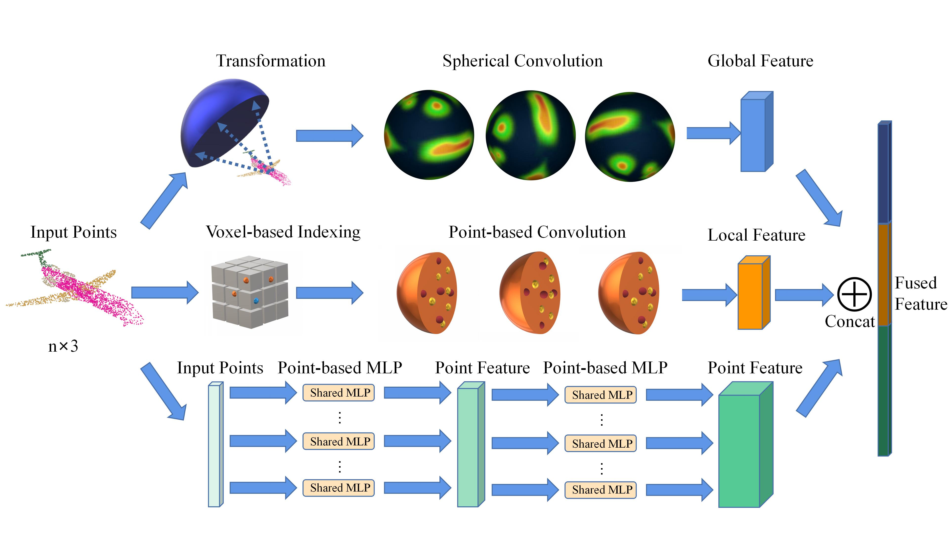
Complementary Multi-Branch CNNs Towards Real-World 3D Point Classification
Zifeng Tang, Fusheng Hao, Qieshi Zhang, Jun Cheng, Jin Zhang, Shuai Yuan
CAS Key Laboratory of Human-Machine Intelligence-Synergy Systems, Shenzhen Institute of Advanced Technology,
Chinese Academy of Science, China
Conventional point-based convolution models are accelerated by utilizing the voxel-based indexing, which reduces 30% time in searching neighbors.
A point-based spherical CNN is proposed to directly process point clouds.
In MBCNN, a fusion strategy is utilized to gain features more comprehensively.
The fusion of 3 various branches.

