Slide 1
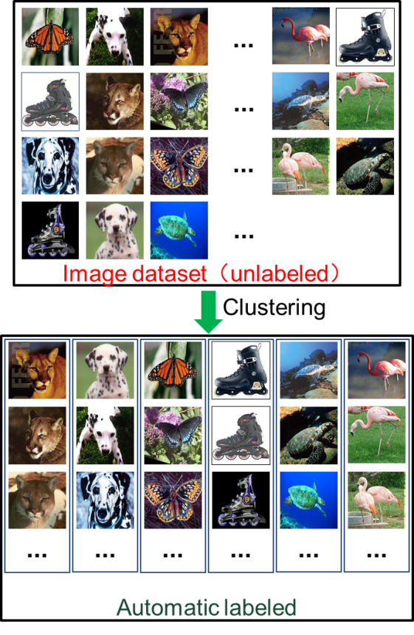
A Survey of Image Clustering: Taxonomy and Recent Methods
Jiaxin Liu¹, Dongwei Wang², Siquan Yu^{3,4,5,*}, Xueliang Li⁶, Zhi Han^{3,4} and Yandong Tang^{3,4}
1. State Grid Liaoning Electric Power Research Institute, Shenyang, China.
2. School of Technology, Beijing Forestry University, Beijing, China.
3. State Key Laboratory of Robotics, Shenyang Institute of Automation, Chinese Academy of Sciences, Shenyang, China.
4. Institutes for Robotics Intelligent Manufacturing, Chinese Academy of Sciences, Shenyang, China.
5. School of Information Science and Engineering, Northeastern University, Shenyang, China.
6. State Grid Shandong Electric Power Company, Shandong, China.
Image clustering is a fundamental problem in computer vision domains. In this survey, we provide a comprehensive survey for image clustering including traditional clustering methods and deep clustering methods. The main contributions of this paper can be summarized as follows:
I) We provide an overview of modern machine learning techniques for image clustering. For each type of image clustering research, we provide detailed descriptions on representative models, and make the necessary comparison.
II) We collect abundant resources on image clustering, including state-of-the-art models, benchmark data sets, common estimation metrics and visualization methods. This survey can be used as a practical guide for understanding image clustering.
The definition of image clustering.

