Slide 1
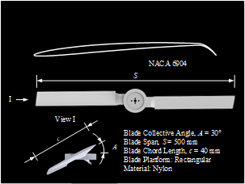
Hover Performance Experimental Setups for a Miniature Mars Rotorcraft Design and Preliminary Experiments
Chunguang Fan, Pengyue Zhao, Jianwei Wu and Zongquan Deng
Ultra Precision Research Institute, Harbin Institute of Technology, China
Design of experimental setups for a miniature Mars rotorcraft.
The measurement of lift by hover test stand is in an indirect way, by which the effect of rotor system's gravity is reduced.
The results show that at the maximum speed of hover test stand, the lift generated by the rotor can achieve approximately 120 gf, which means that it is possible for a coaxial rotorcraft with 200 g mass to fly in Martian atmosphere.
Rotor model and parameters

