Slide 1
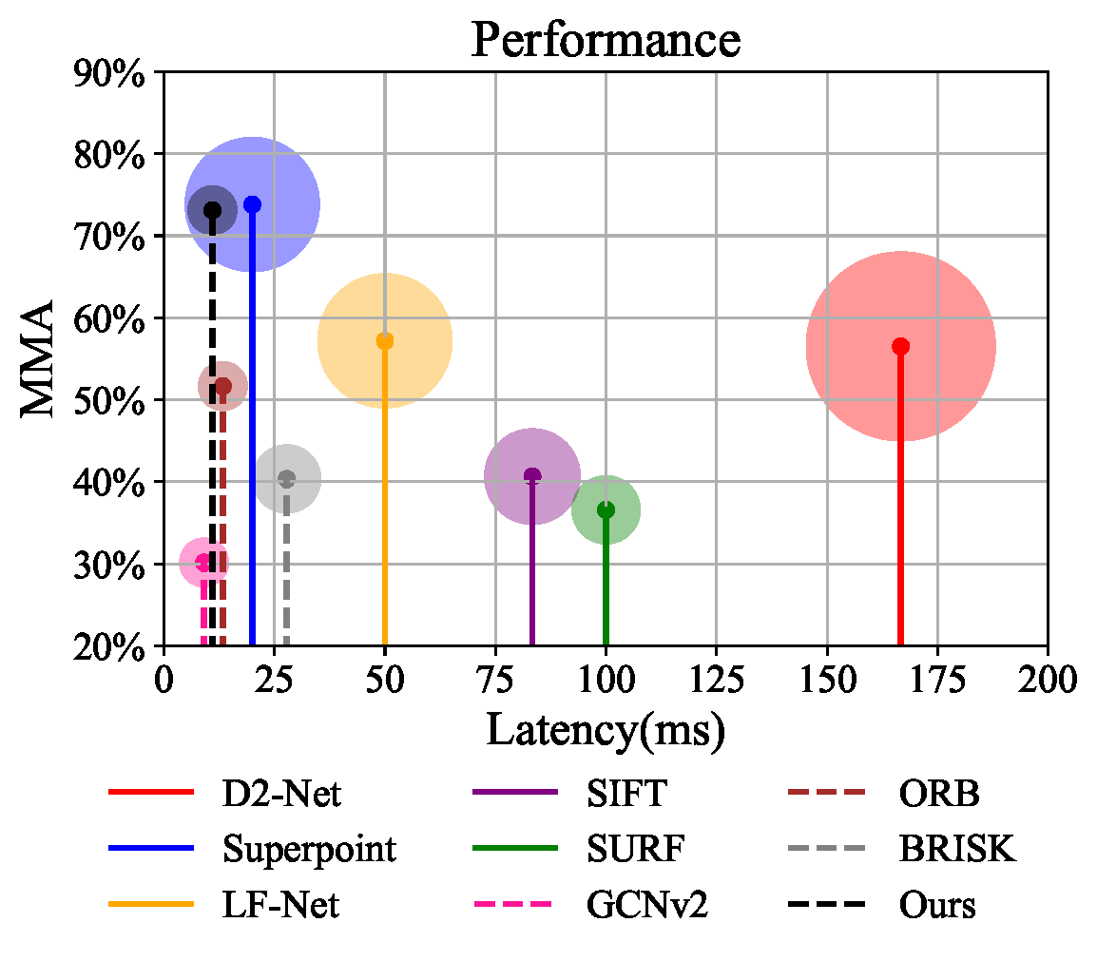
Self-supervised Feature Detection and Binary Description in Hamming Space for Mobile Platforms
Shenghao Li, Guibao Zhang and Qunfei Zhao
Department of Automation, Shanghai Jiao Tong University, China
This paper proposes to use self-supervised learning and iterative hash for feature detection and description.
Local features with repeatability and robustness are extracted with low latency and memory footprint.
The proposed method empowers real-time feature-based tasks in Hamming space on mobile platforms.
Local Feature Qualitative Comparison

