Slide 1
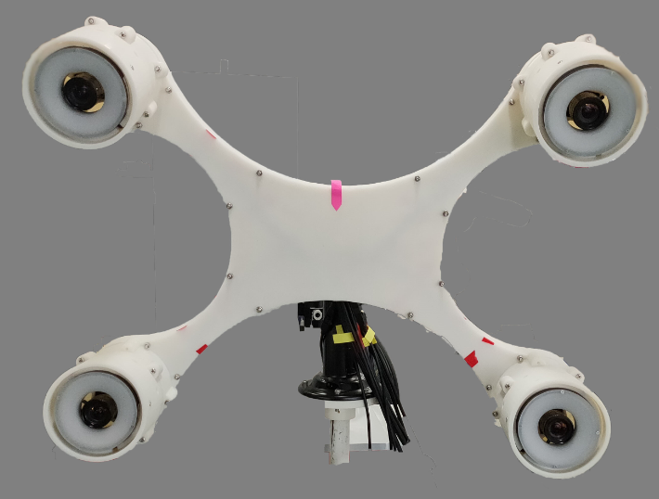
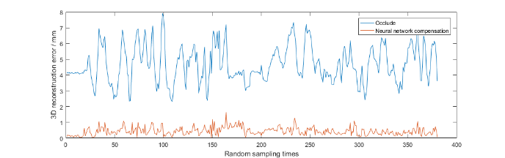
Switching fluctuation compensation of the multi-view optical positioning system under camera occlusion
Zhengjun Yu, Shibo Li*, Ying Hu
Shenzhen Institute of Advanced Technology, Chinese Academy of Sciences, China
Haiyang Jin*
Shenzhen Broadcare medical robotics co. Ltd., China
Gang Yu
Harbin Institute of Technology (Shenzhen), China
Positioning system measurement model and System switching fluctuation under camera occlusion
Vanished image point prediction based on neural network
Simulation of system switching fluctuation and compensation based on neural network
System switching fluctuation compensation in real environment
System switching fluctuation compensation for four-view optical positioning system

