Slide 1
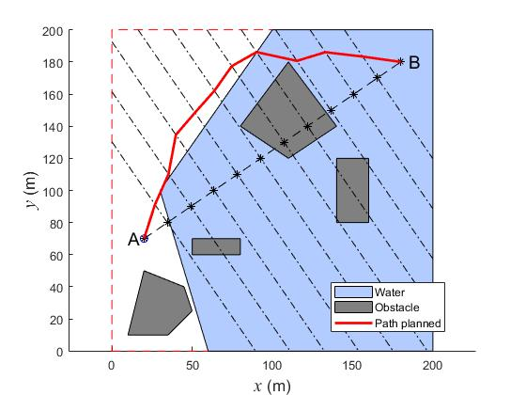
A Fireworks Algorithm Based Path Planning Method for Amphibious Robot
Yuanyang Qi and Junzhi Yu
College of Engineering, Peking University, China
Jincun Liu
College of Information and Electrical Engineering, China Agricultural University, China
A path planning method adopting the Fireworks Algorithms (FWA) is proposed.
An optimization model is designed aiming at the characteristics of path planning for amphibious robots.
Simulation experiments are conducted to analyze and compare the performance of FWA variants.
Amphibious environment and path planned using proposed method

