Slide 1
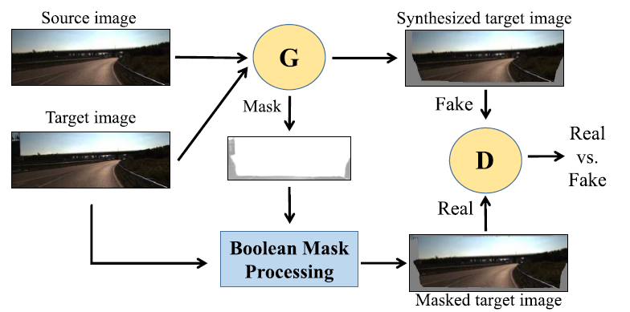
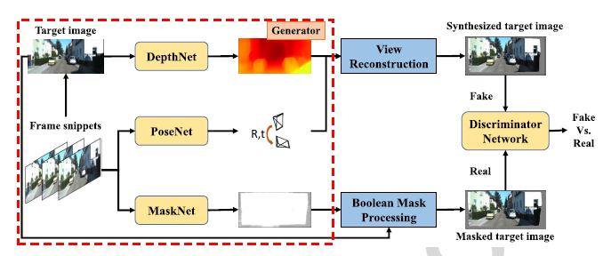
Masked GAN for Unsupervised Depth and Pose Prediction with Scale Consistency
Chaoqiang Zhao and Yang Tang
East China University of Science and Technology, China
We introduce a masked GAN framework for unsupervised pose and depth estimation.
We discuss the effect of unreconstructed regions on adversarial learning.
We consider the scale-inconsistent problem and propose a adaptive constraint for a better global trajectory prediction.
Both the pose and depth networks proposed in this paper show competitive results on public datasets.
Architecture overview.

