Slide 1
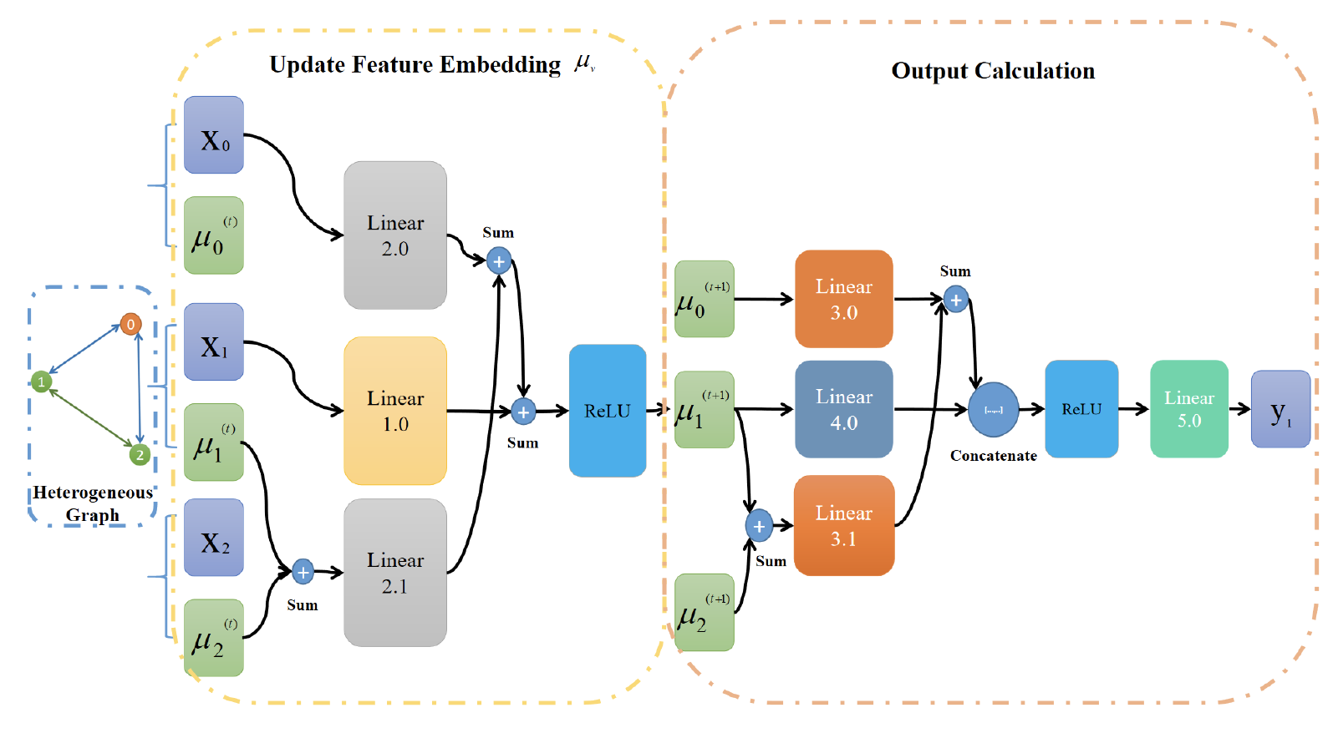
Multi-Agent Trajectory Prediction Based on Graph Neural Network
Haozhe Du, Zhike Chen, Yufeng Wang, Zheyuan Huang, Yunkai Wang and Rong Xiong
Institute of Cyber-Systems and Control, Zhejiang University, China
Construct ZJUNlictSSL dataset for multi-agent prediction problems.
Propose a heterogeneous graph neural method for multi-agent prediction problems.
Our method focuses on enviroment and tasks of agents in problems.
Present a new view for graph-like scenes in multi-agent prediction problems.

