Slide 1
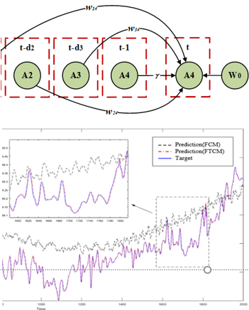
IEEE RCAR 2020 Digest Template
Prediction of Key Parameters of Coal Gasification
Process Based on TM-FTCM
Congbin Jiang, Dan Wang, Cuiping Gong, Gang Zhang, Wen Gu, Lifeng Yang and Xingqiang Ding
Changzheng Engineering Co.,Limited,China
The development of coal chemical industry has become a concern
The time delay leads to the prediction model problems of poor interpretation and low accuracy.
The method effectively solves the problem of inaccurate prediction model due to delay .
A figure here
For figure caption (optional), use arial narrow 20pt font

