Slide 1
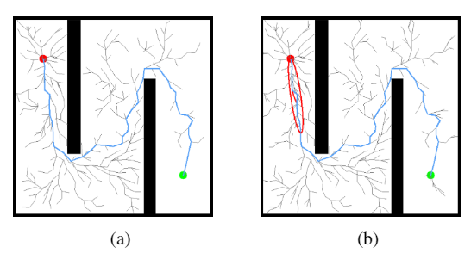
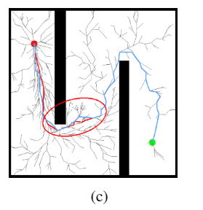
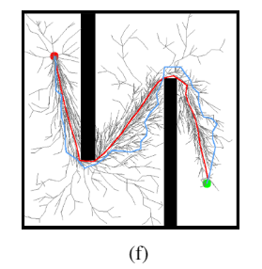
Sliding-Window Informed RRT*: A Method for Speeding Up the Optimization and Path Smoothing
Chenming Li¹, Chaoqun Wang², Jiankun Wang³, Yutian Shen¹
¹EE, CUHK, HKSAR, China; ² CSE, SDU, China;
Max Q.-H. Meng^{3*}
³Department of Electronic and Electrical Engineering, SUSTech, China
A sliding-window method is proposed to accelerate the convergence of Informed RRT* .
The Softmax Action Selection-like method is applied to balance the exploration and exploitation, and guarantee the probabilistic completeness .
Simulation experiments are carried out to demonstrate that our method can improve performance significantly.

