Slide 1
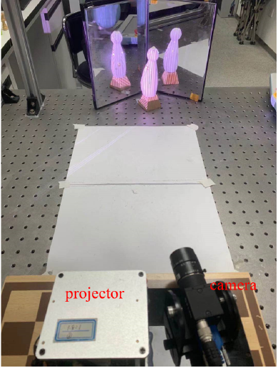
A full-body 3D reconstruction using planar mirrors
Pengju Xie, Yuping Ye, Lijun Shu and Zhan Song
Shenzhen Institute of Advanced Technology, University of Chinese Academy of Sciences, China
This paper proposed an SL-based full-body 3D reconstruction method utilizing two planar mirrors.
Our method adapted the light reflection principle and comprehensively considered the calibration problem essential for the point cloud registration.
A figure here
For figure caption (optional), use arial narrow 20pt font

