Slide 1
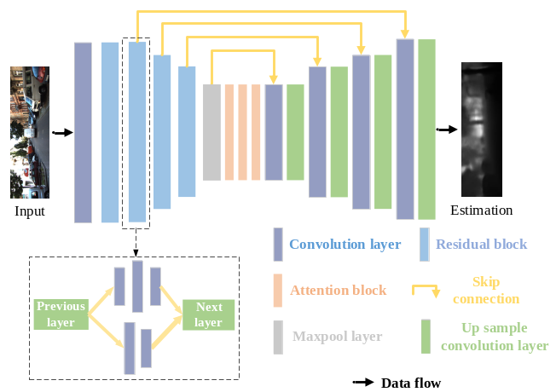
Attention Mechanism-based Monocular Depth Estimation and Visual Odometry
Qieshi Zhang, Dian Lin, Ziliang Ren, Yuhang Kang, Fuxiang Wu, Jun Cheng
Shenzhen Institute of Advanced Technology, Chinese Academy of Sciences, China
Propose a depth estimation network encoder based on attention mechanism for predicting the spatial features of the adjacent frames.
Improve the depthwise separable convolution to replace the convolution layers in the main architecture for improving efficiency.
Validate the performance of our algorithm on a public dataset and real-world experiments with our mobile robot, including outdoor and indoor with ground truth.

