Slide 1
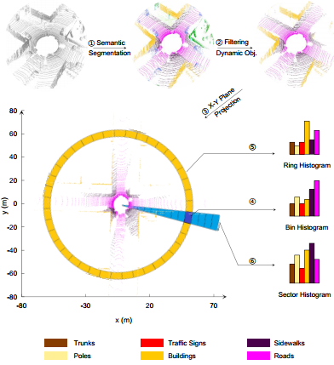
Semantic Scan Context: Global Semantic Descriptor for LiDAR-based Place Recognition
Yuxiang Li, Pengpeng Su, Ming Cao, Haoyao Chen and Xin Jiang
Harbin Institute of Technology, Shenzhen, China
Yunhui Liu
The Chinese University of Hong Kong, China
A global semantic descriptor for finding loop closures using 3D LiDAR.
Ring keys and sector keys based on semantic histograms for fast retrieval and alignment.
Three-stage retrieval for fast and accurate matching of the proposed descriptors.
Competitive performance in challenging situations for place recognition.
A figure here
For figure caption (optional), use arial narrow 20pt font

