Slide 1
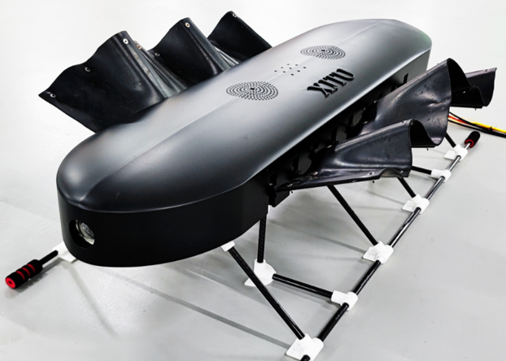
The Ground Motion Dynamics Analysis of a Bionic Amphibious Robot with Undulatory Fins
Yangbin Zeng, Qiao Hu*, Shenglin Yin
Baocheng Tong and Tangjia Zhang
Department of Mechanical Engineering, Xi’an Jiaotong University, China
A novel type of bionic undulatory fin robot is designed.
The kinematics of undulatory fin is modeled based on the ruled surface model.
The ground dynamics of undulatory fin is analyzed based on wheel dynamics.
The research focus is verified through experiments.
The novel bionic robot with undulatory fins

