Slide 1
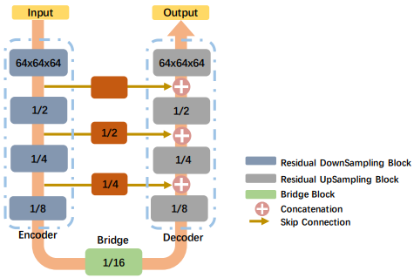
Attention Residual Network with 3D convolutional neural network for 3D Human Pose Estimation
Jianyu Yan and Kuizhi Mei
Institute of Artificial Intelligence and Robotics, Xi’an Jiaotong University, China
We proposed a method estimate 3D pose from voxelized grid data. Our method output the heat map, which contains per-voxel likelihood for each joint.
We evaluated our method on public dataset, ITOP dataset; and collect a 3D human pose estimation dataset to evaluate our method
We design a attention block to help network focus on more important information.
A figure here
The Architecture of Network

