Slide 1
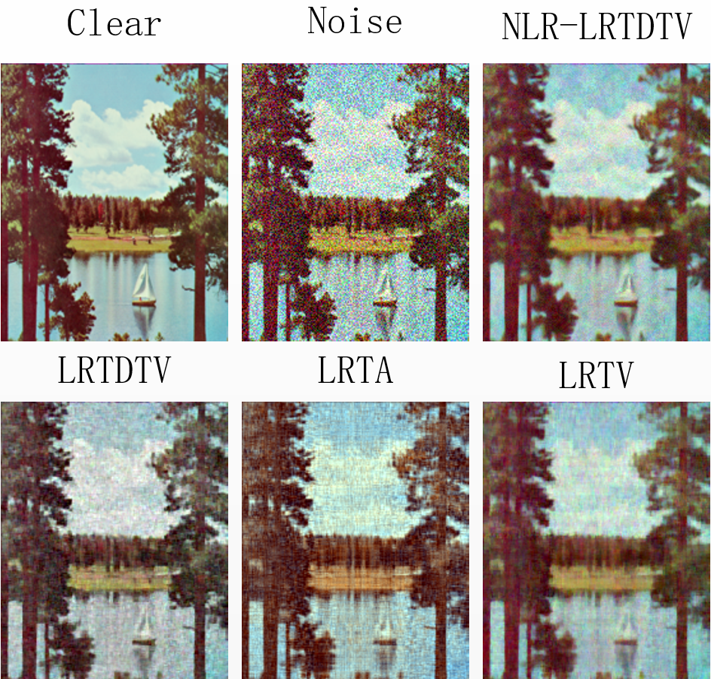
Total Variation Regularized Low-Rank Tensor Decomposition with
nonlocal for single image denoising
Shengchuan Li¹, Yanmei Wang^{3,4,5}, Qiong Luo^{*3,4,5}, Kai Wang², Zhi Han^{3,4} and Yandong Tang^{3,4}
1. State Grid Liaoning Electric Power Research Institute, Shenyang, China
2. State Grid Shandong Electric Power Company, Shandong, China
3. State Key Laboratory of Robotics, Shenyang Institute of Automation, Chinese Academy of Sciences, Shenyang, China
4. Institutes for Robotics and Intelligent Manufacturing, Chinese Academy of Sciences, Shenyang, China;
5. University of Chinese Academy of Sciences, Beijing, China
Sparse noise and Gaussian noise are modeled separately.
Introducing the non-local prior into tensor decomposition with TV model.
Experiments prove the effectiveness of the proposed method.
Comparison of different methods under different noise cases

