Slide 1
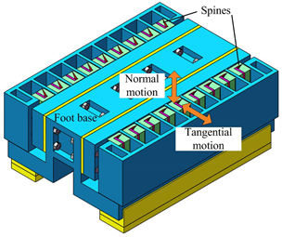
Design of a Spiny Foot with Fluid-filled Sacs for Climbing Robots
Yanwei Liu, Xiang Huang, Hao Pan, Shujuan Li, Pengyang Li
School of Mechanical and Precision Instrument Engineering,
Xi'an University of Technology, China.
The spiny foot was inspired by the fluid-filled sac in gecko’s foot for force distribution.
All spines’ tangential and normal motion of are actuated by two fluid-filled sacs respectively.
The spiny foot is capable of adapting to the complex topography of rough wall surfaces.
The spiny foot prototype is able to carry 540 g extra payload on inverted rough surfaces.
Spiny foot with spines actuated by fluid-filled Sacs.

